Slide 1
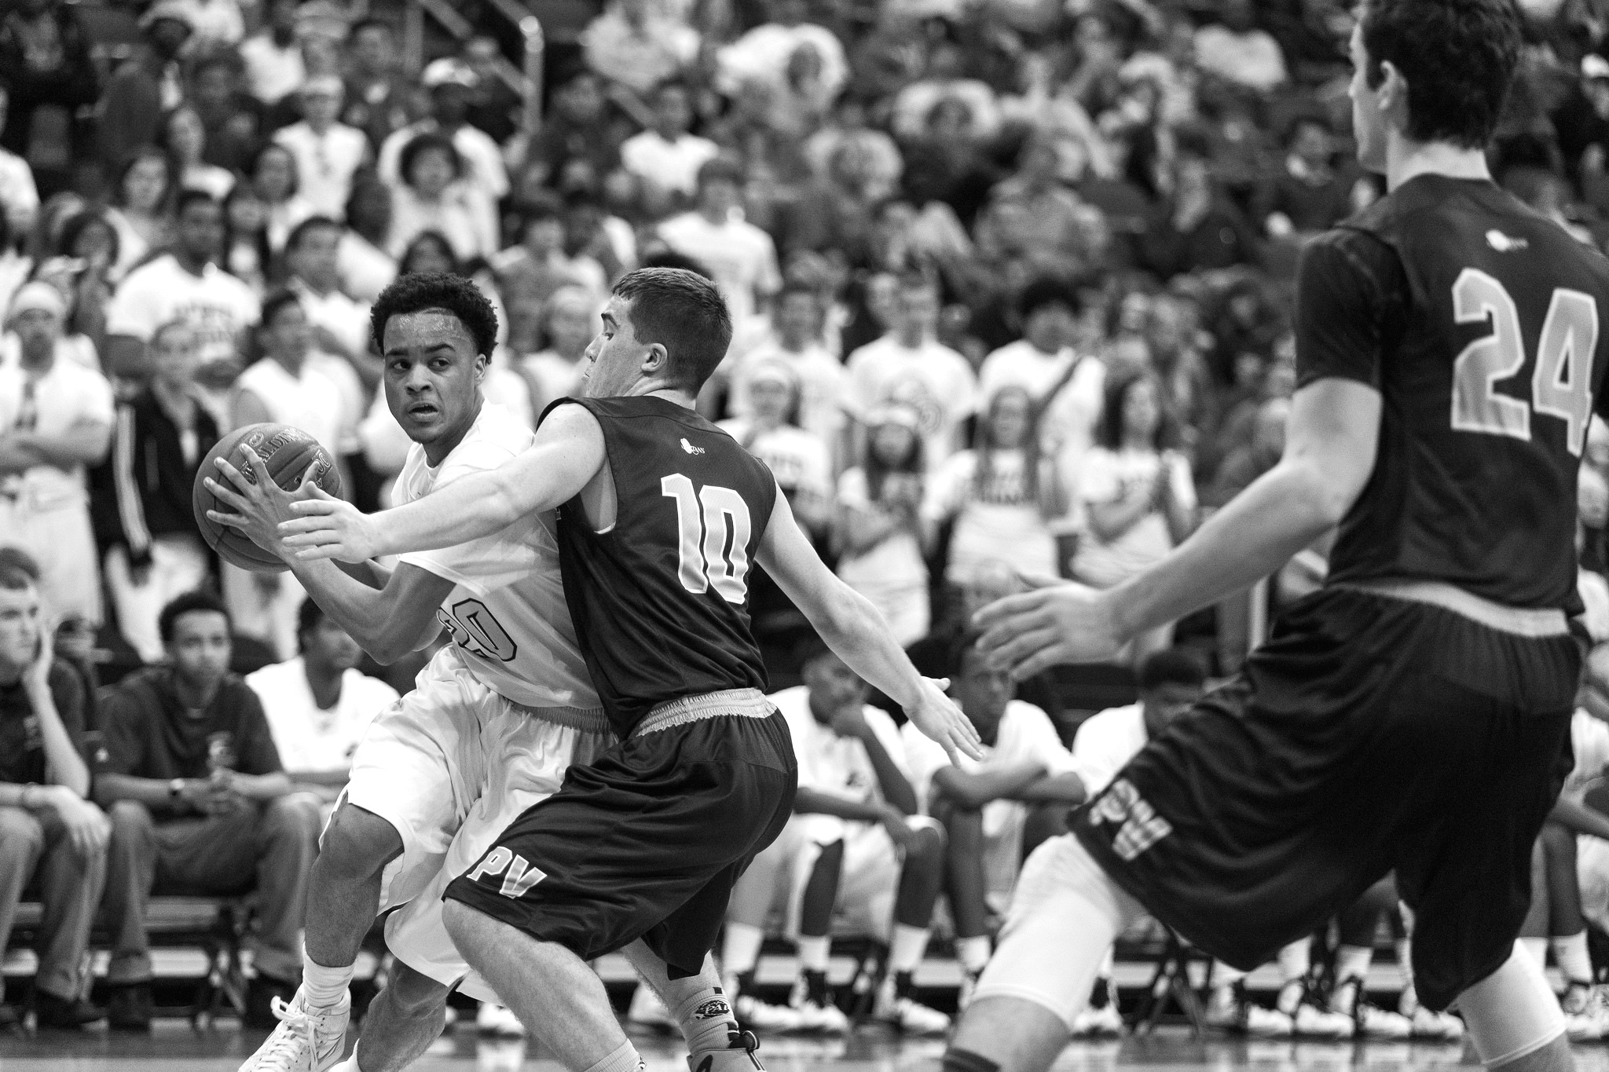

TASK
MADNESS
ON DEMAND
PROCESSING WITH
SPRING CLOUD TASK
TASK MADNESS
ON DEMAND PROCESSING WITH SCT
Notes:
https://www.flickr.com/photos/tabor-roeder/16811793545/

Slide 2
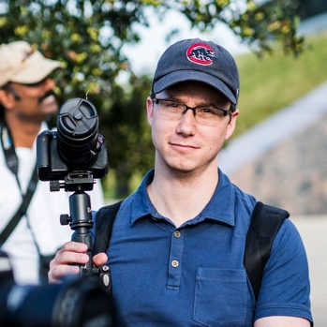
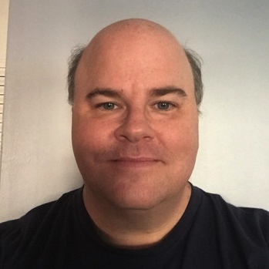
WHO ARE WE?
MICHAEL MINELLA
@michaelminella
@OffHeap
Github: mminella
https://www.spring.io
GLENN RENFRO
@cppwfs
Github: cppwfs
https://www.spring.io

Slide 3
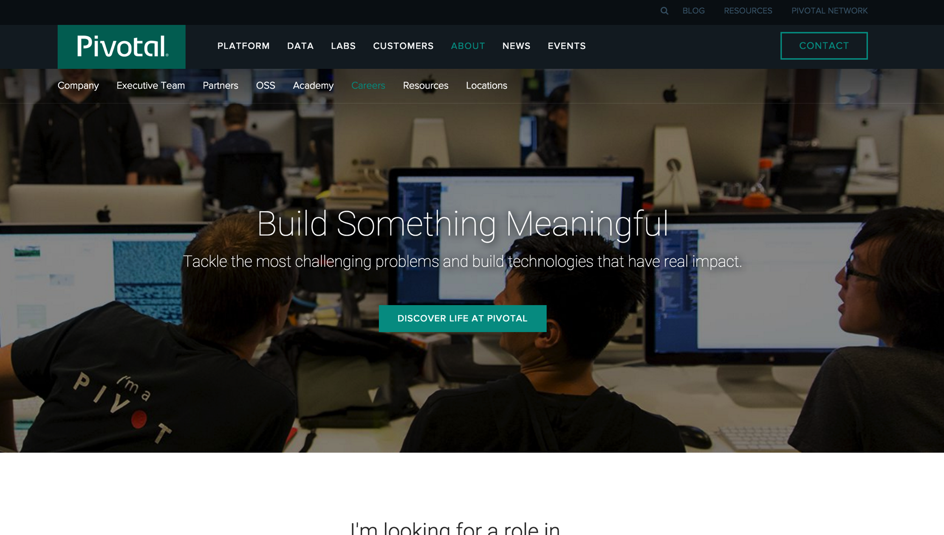

Slide 4
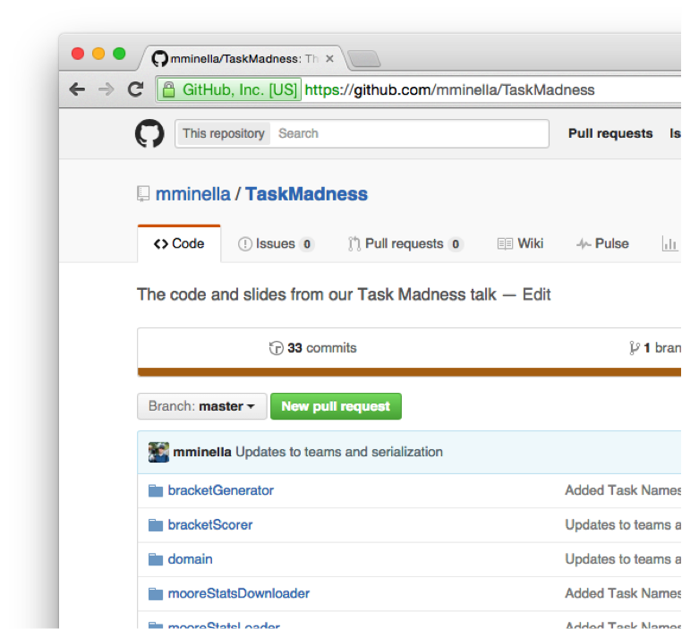

CODE IS ON GITHUB
https://github.com/mminella/TaskMadness

Slide 5

PLEASE ASK
QUESTIONS

Slide 6


Slide 7


QUICK
POLL

Slide 8
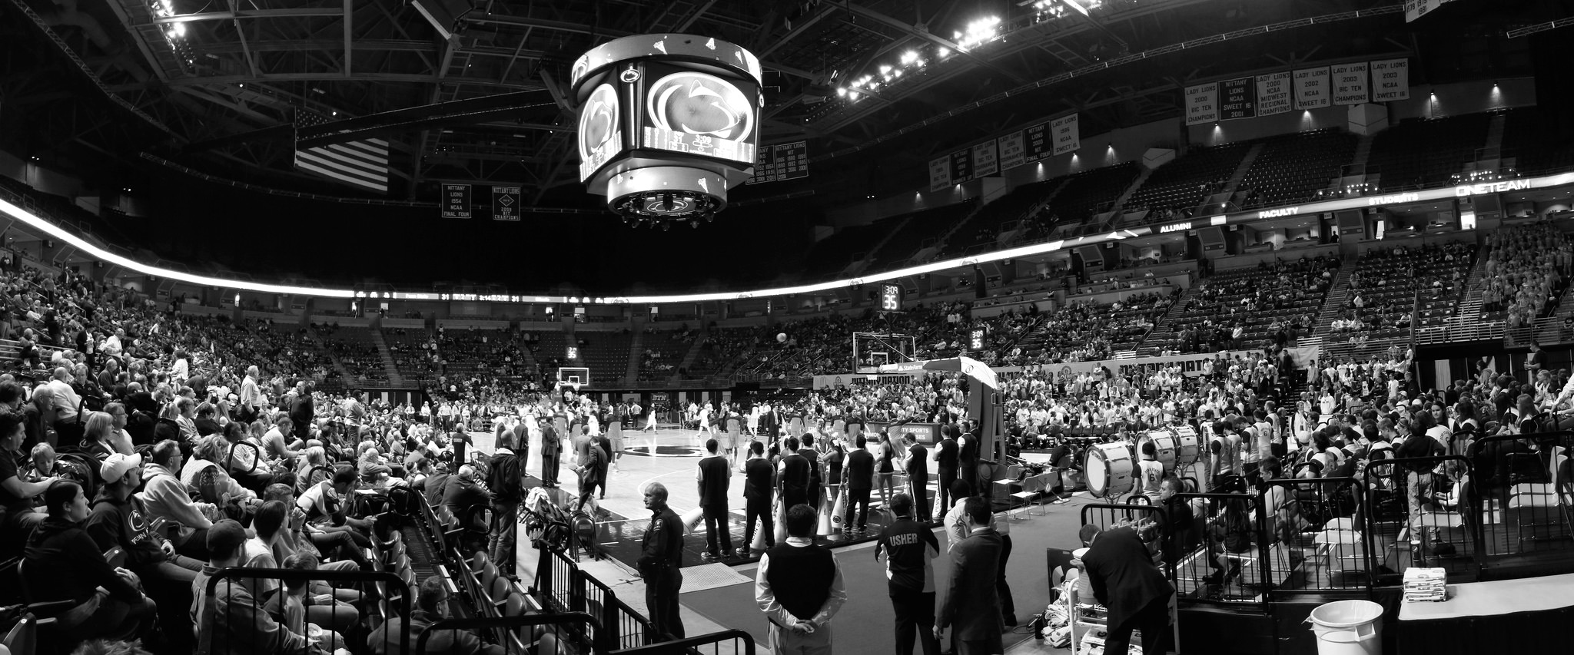
NCAA
MEN’S
BASKETBALL
TOURNAMENT
NCAA Tournament
Notes:
https://www.flickr.com/photos/yuan2003/12959533413/

Slide 9
$240 Million
vs
$1.15 Billion
11 Million
$2 Billion+

Slide 10
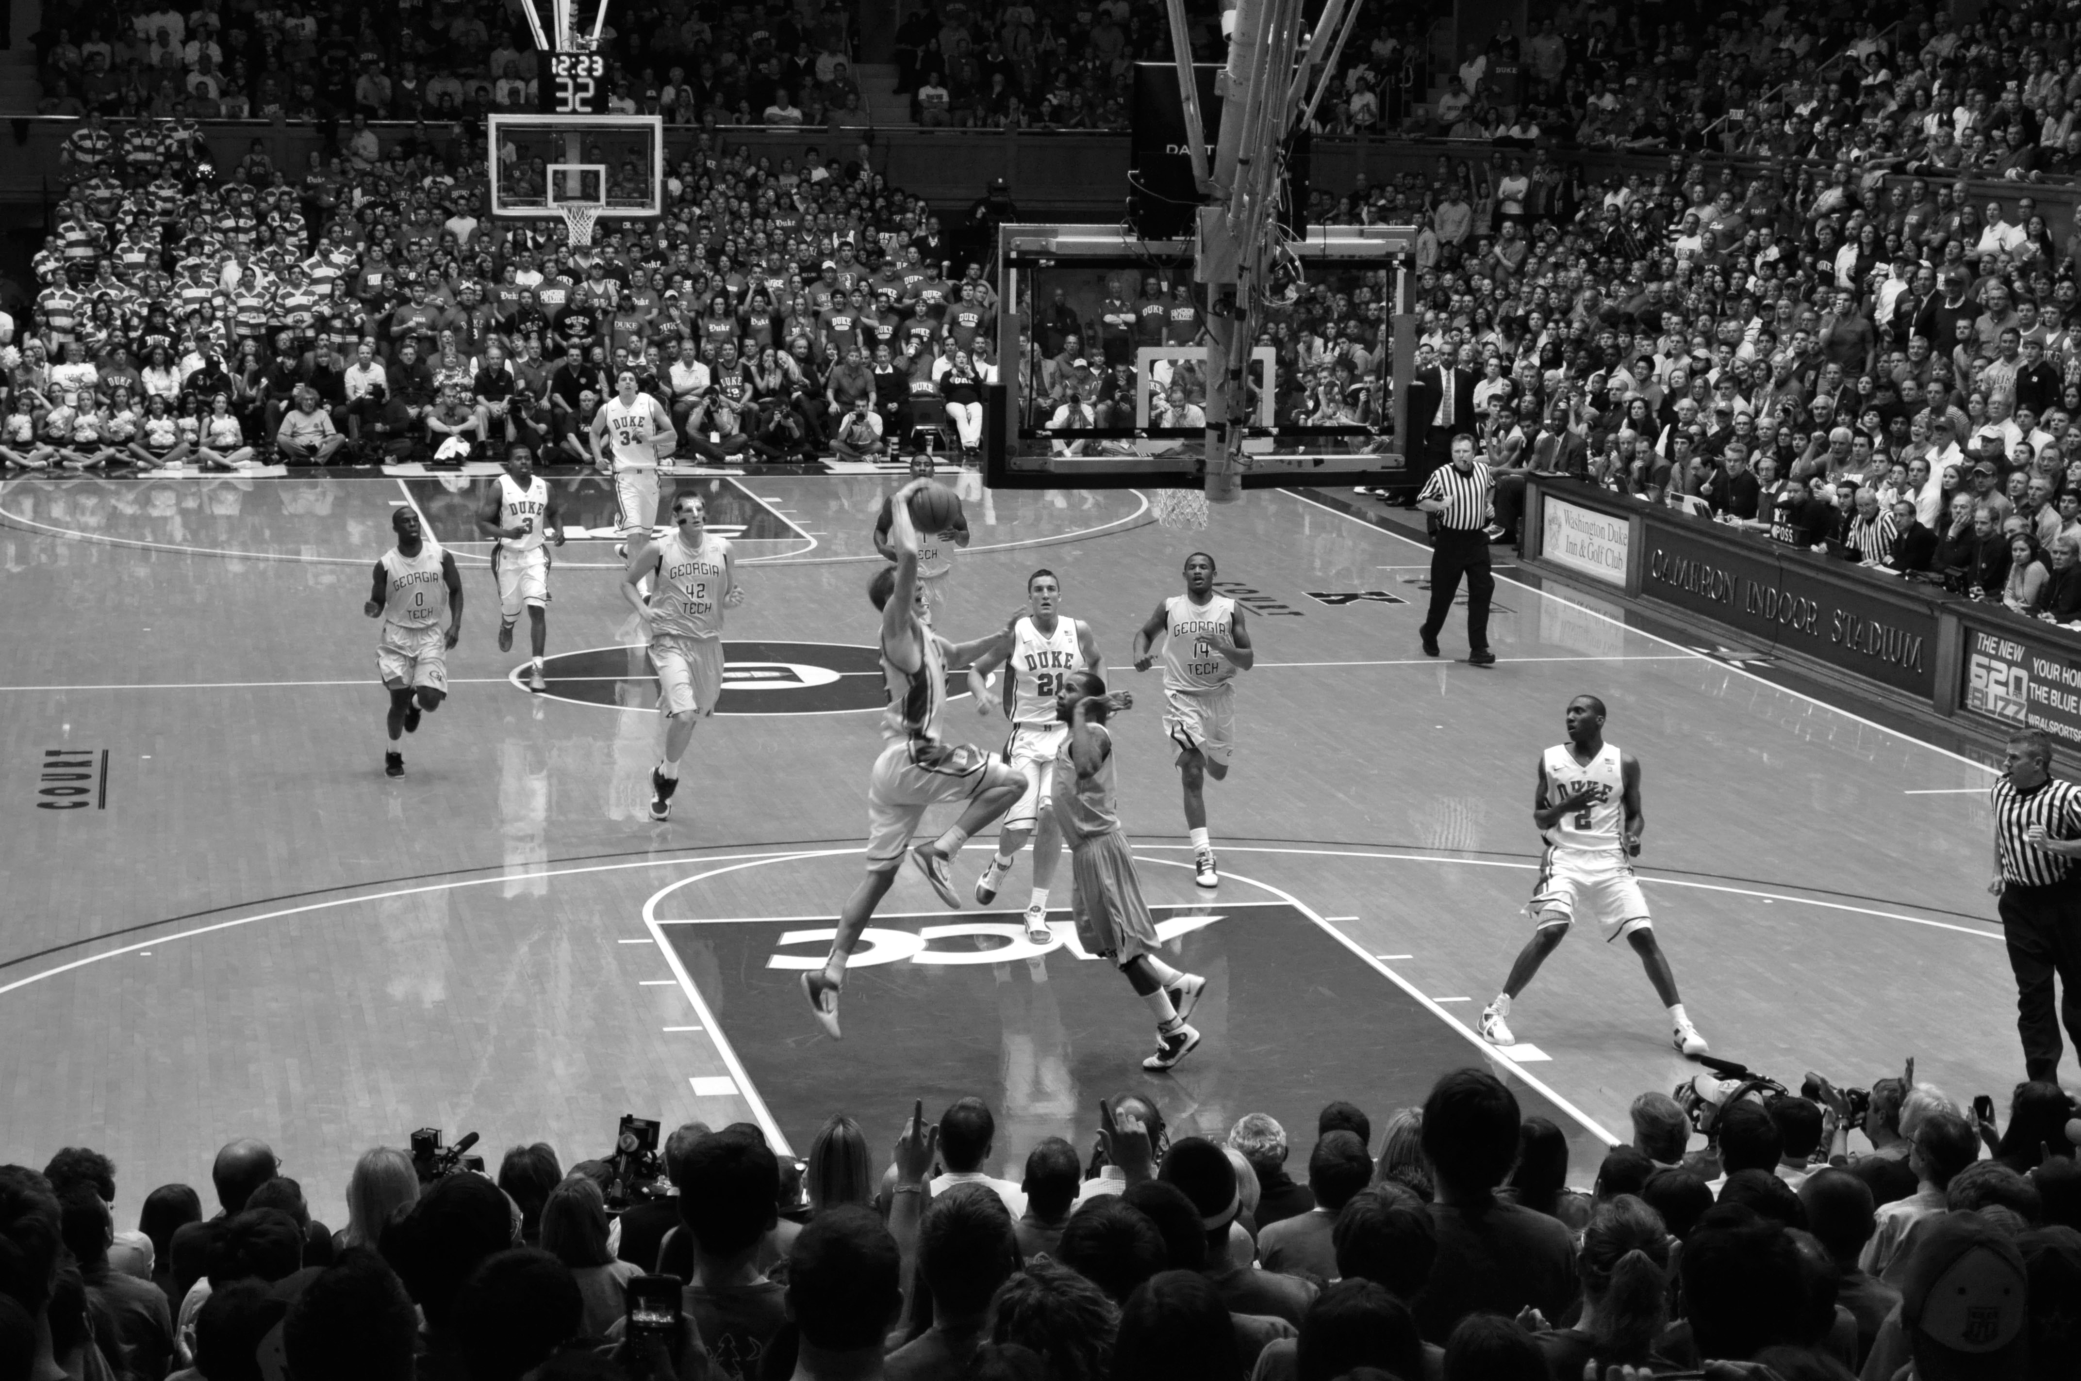

ABOUT THE
TOURNAMENT
Notes:
https://www.flickr.com/photos/whateyesee13/5472188211/

Slide 11
64
TEAMS

Slide 12
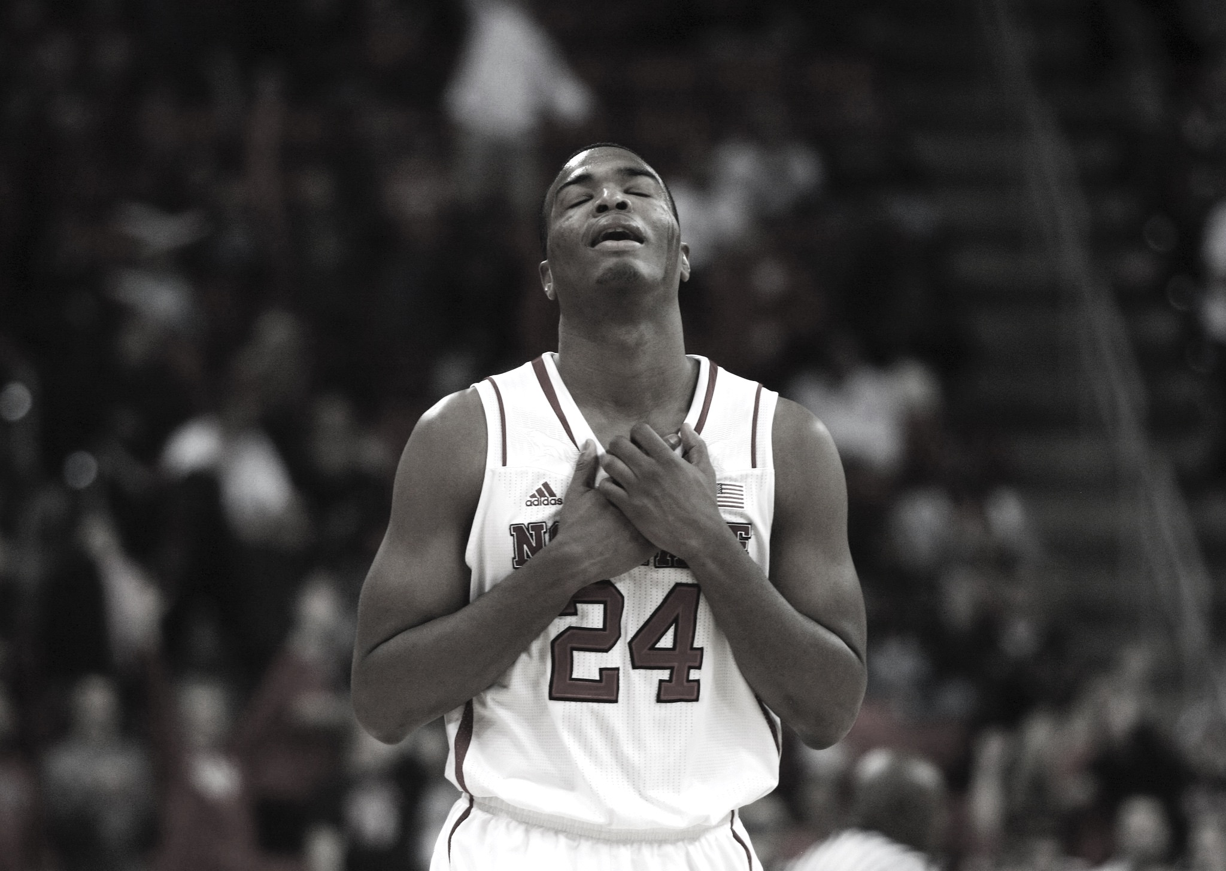

Single elimination
SINGLE
ELIMINATION
Notes:
https://www.flickr.com/photos/romec1/12229748395/

Slide 13
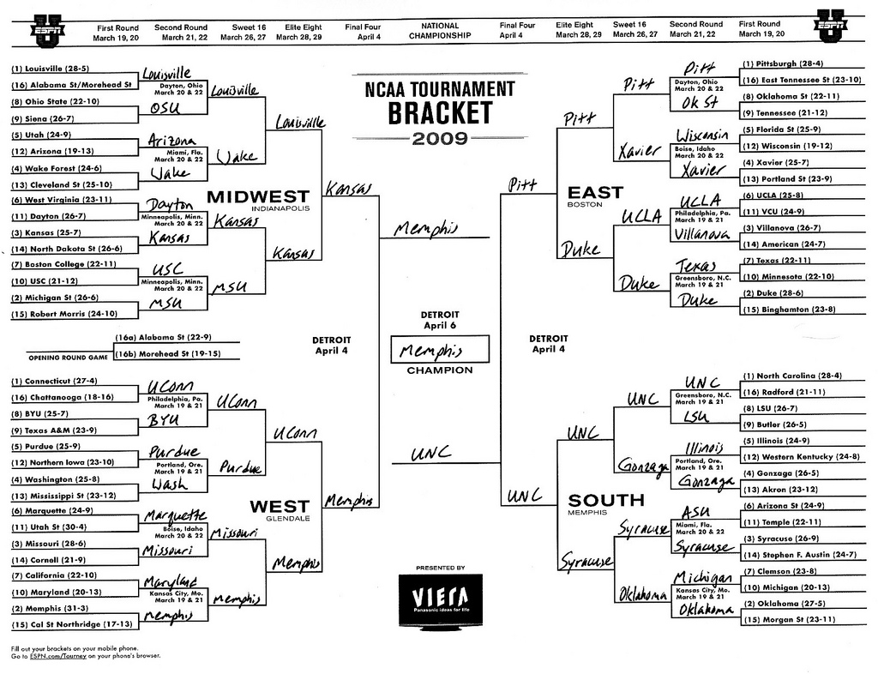
TEAMS
ARE
SEEDED
Teams are seeded

Slide 14
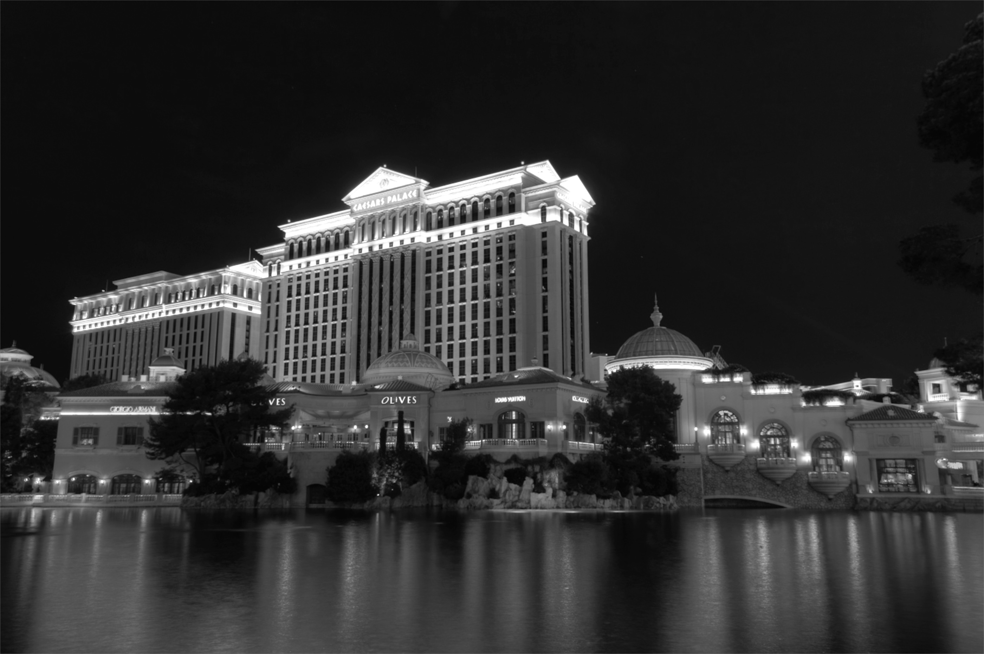

GAMBLING
BASED ON
BRACKETS
Notes:
http://keepingitrealsports.com/wp-content/uploads/2015/03/Obama-Katz.jpg

Slide 15

Not that hard right?
PICK
A PERFECT
BRACKET…
EASY RIGHT?

Slide 16
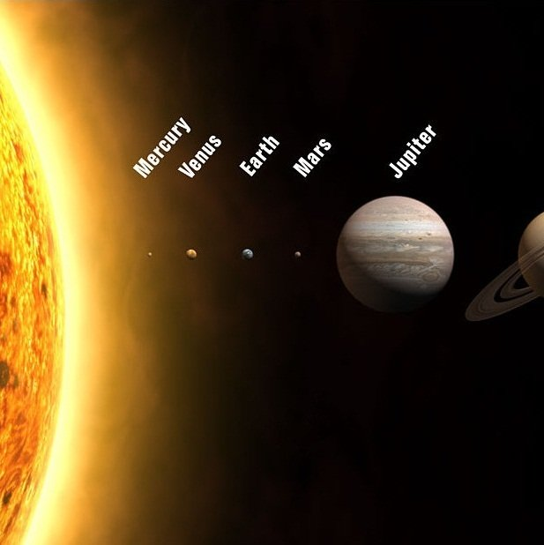
1 IN
9.2 QUINTILIAN
Notes:
Dollars across the solar system nearly 84 times!

Slide 17

NOT
PERFECT
JUST
GOOD
ENOUGH
Notes:
https://www.flickr.com/photos/86530412@N02/7987532186/

Slide 18

WHAT IS
“GOOD
ENOUGH”?

Slide 19
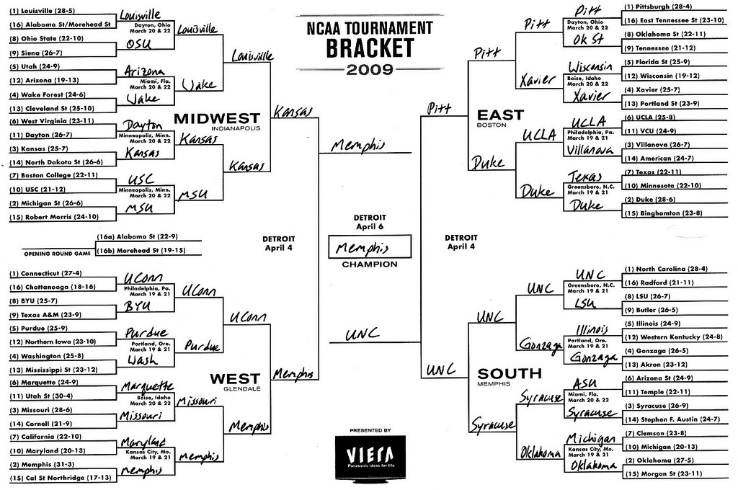

ESPN SCORING RULES
SCORING
RULES

Slide 20
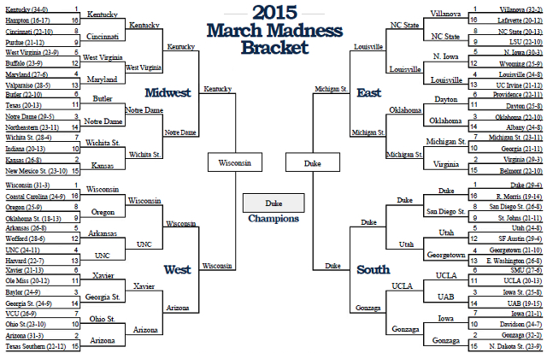
Notes:
3 #1 seeds made the final 4
A #7 seed was the other (that was the “odd” part).
#1 seed (Duke) won

Slide 21

PERFECT
BRACKET IS
1920
Notes:
320 per round * 6 rounds

Slide 22
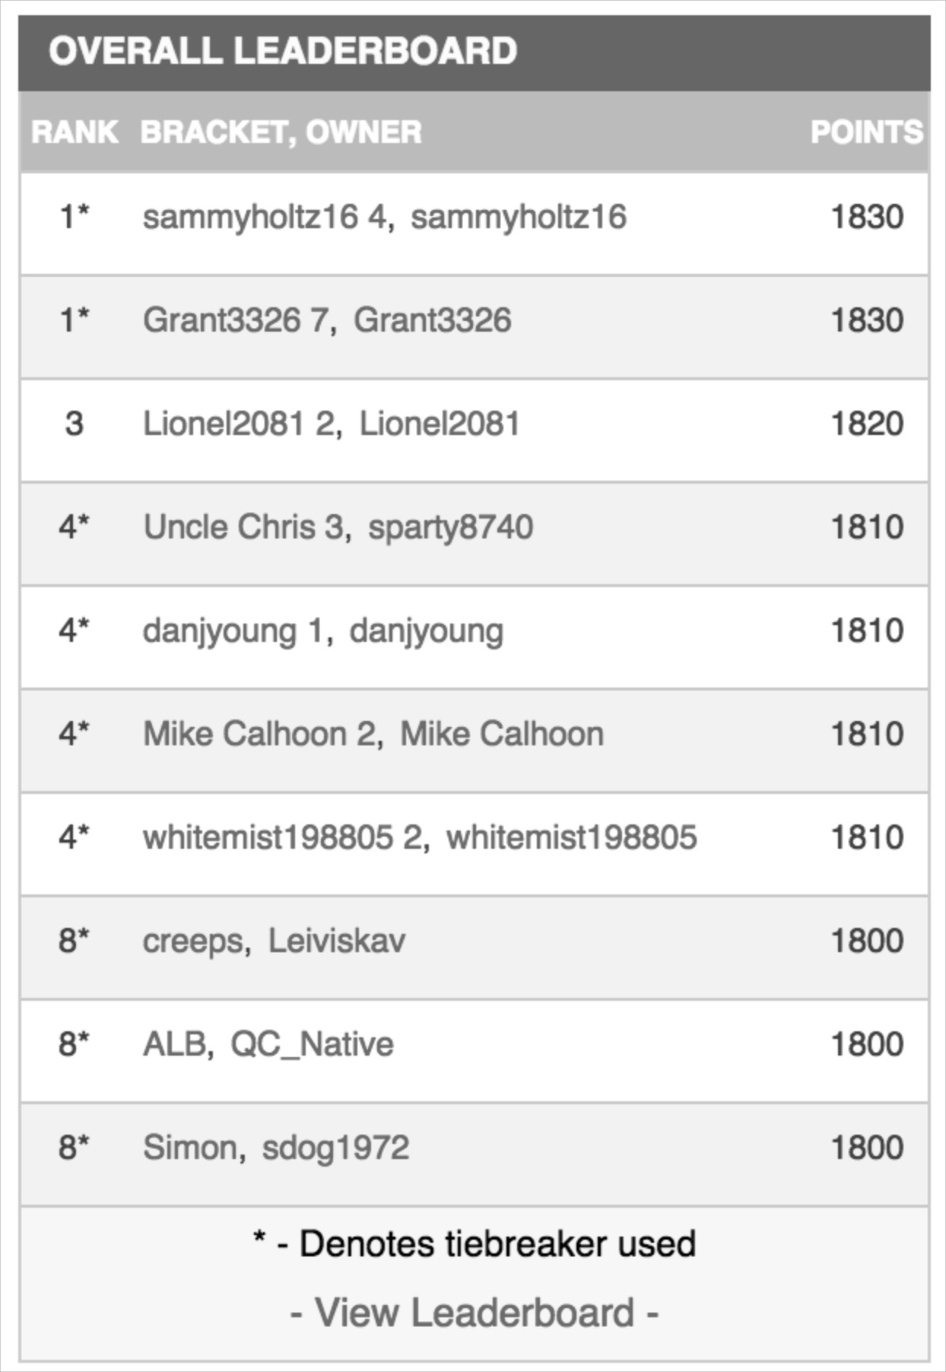

WINNER
SCORED 1830

Slide 23
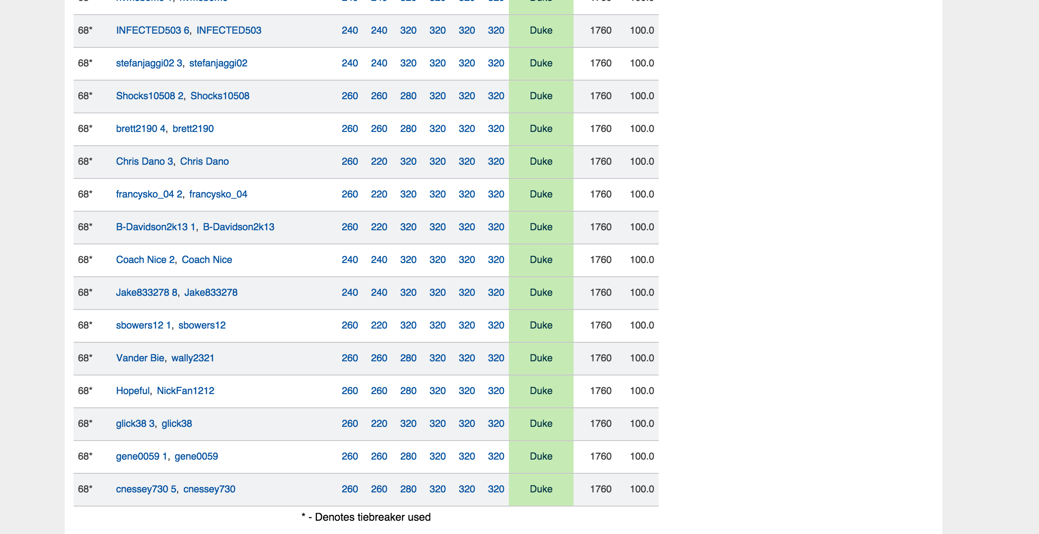
TOP 100
SCORED 1760
Notes:
Top 100 out of 11 million brackets
2014, a much crazier year…The winner had 1730 and to break the top 100, you needed a 1520

Slide 24
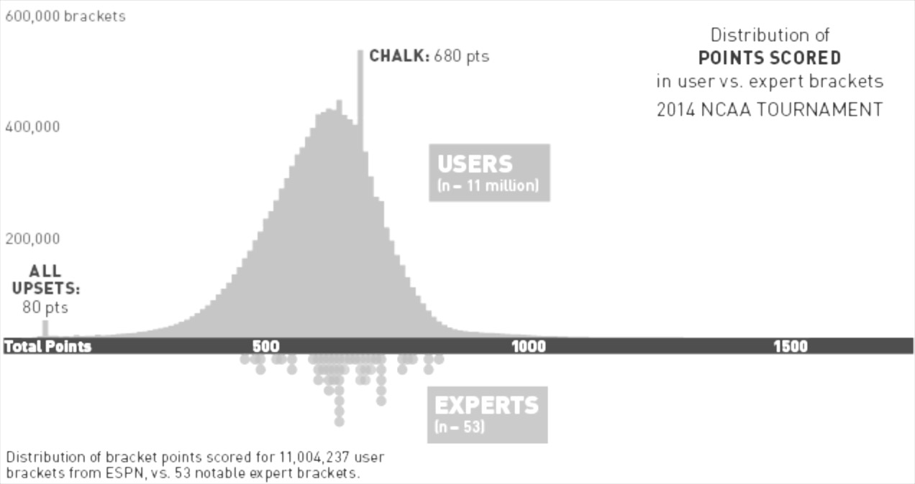

SCORES
TYPICALLY
HAVE A TIGHT
BELL CURVE

Slide 25
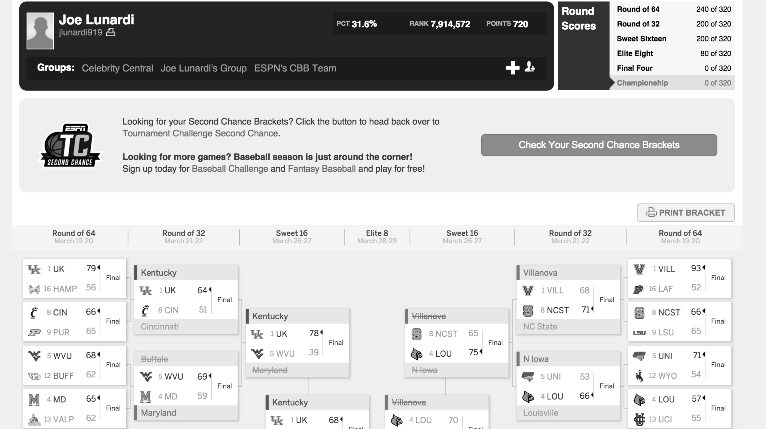
JOE
LUNARDI
720
Joe Lunardi scored 760 in 2015 and 600 in 2014
Notes:
http://games.espn.go.com/tournament-challenge-bracket/2015/en/entry?entryID=4607369

Slide 26

NOT LOOKING FOR A
PERFECT BRACKET

Slide 27
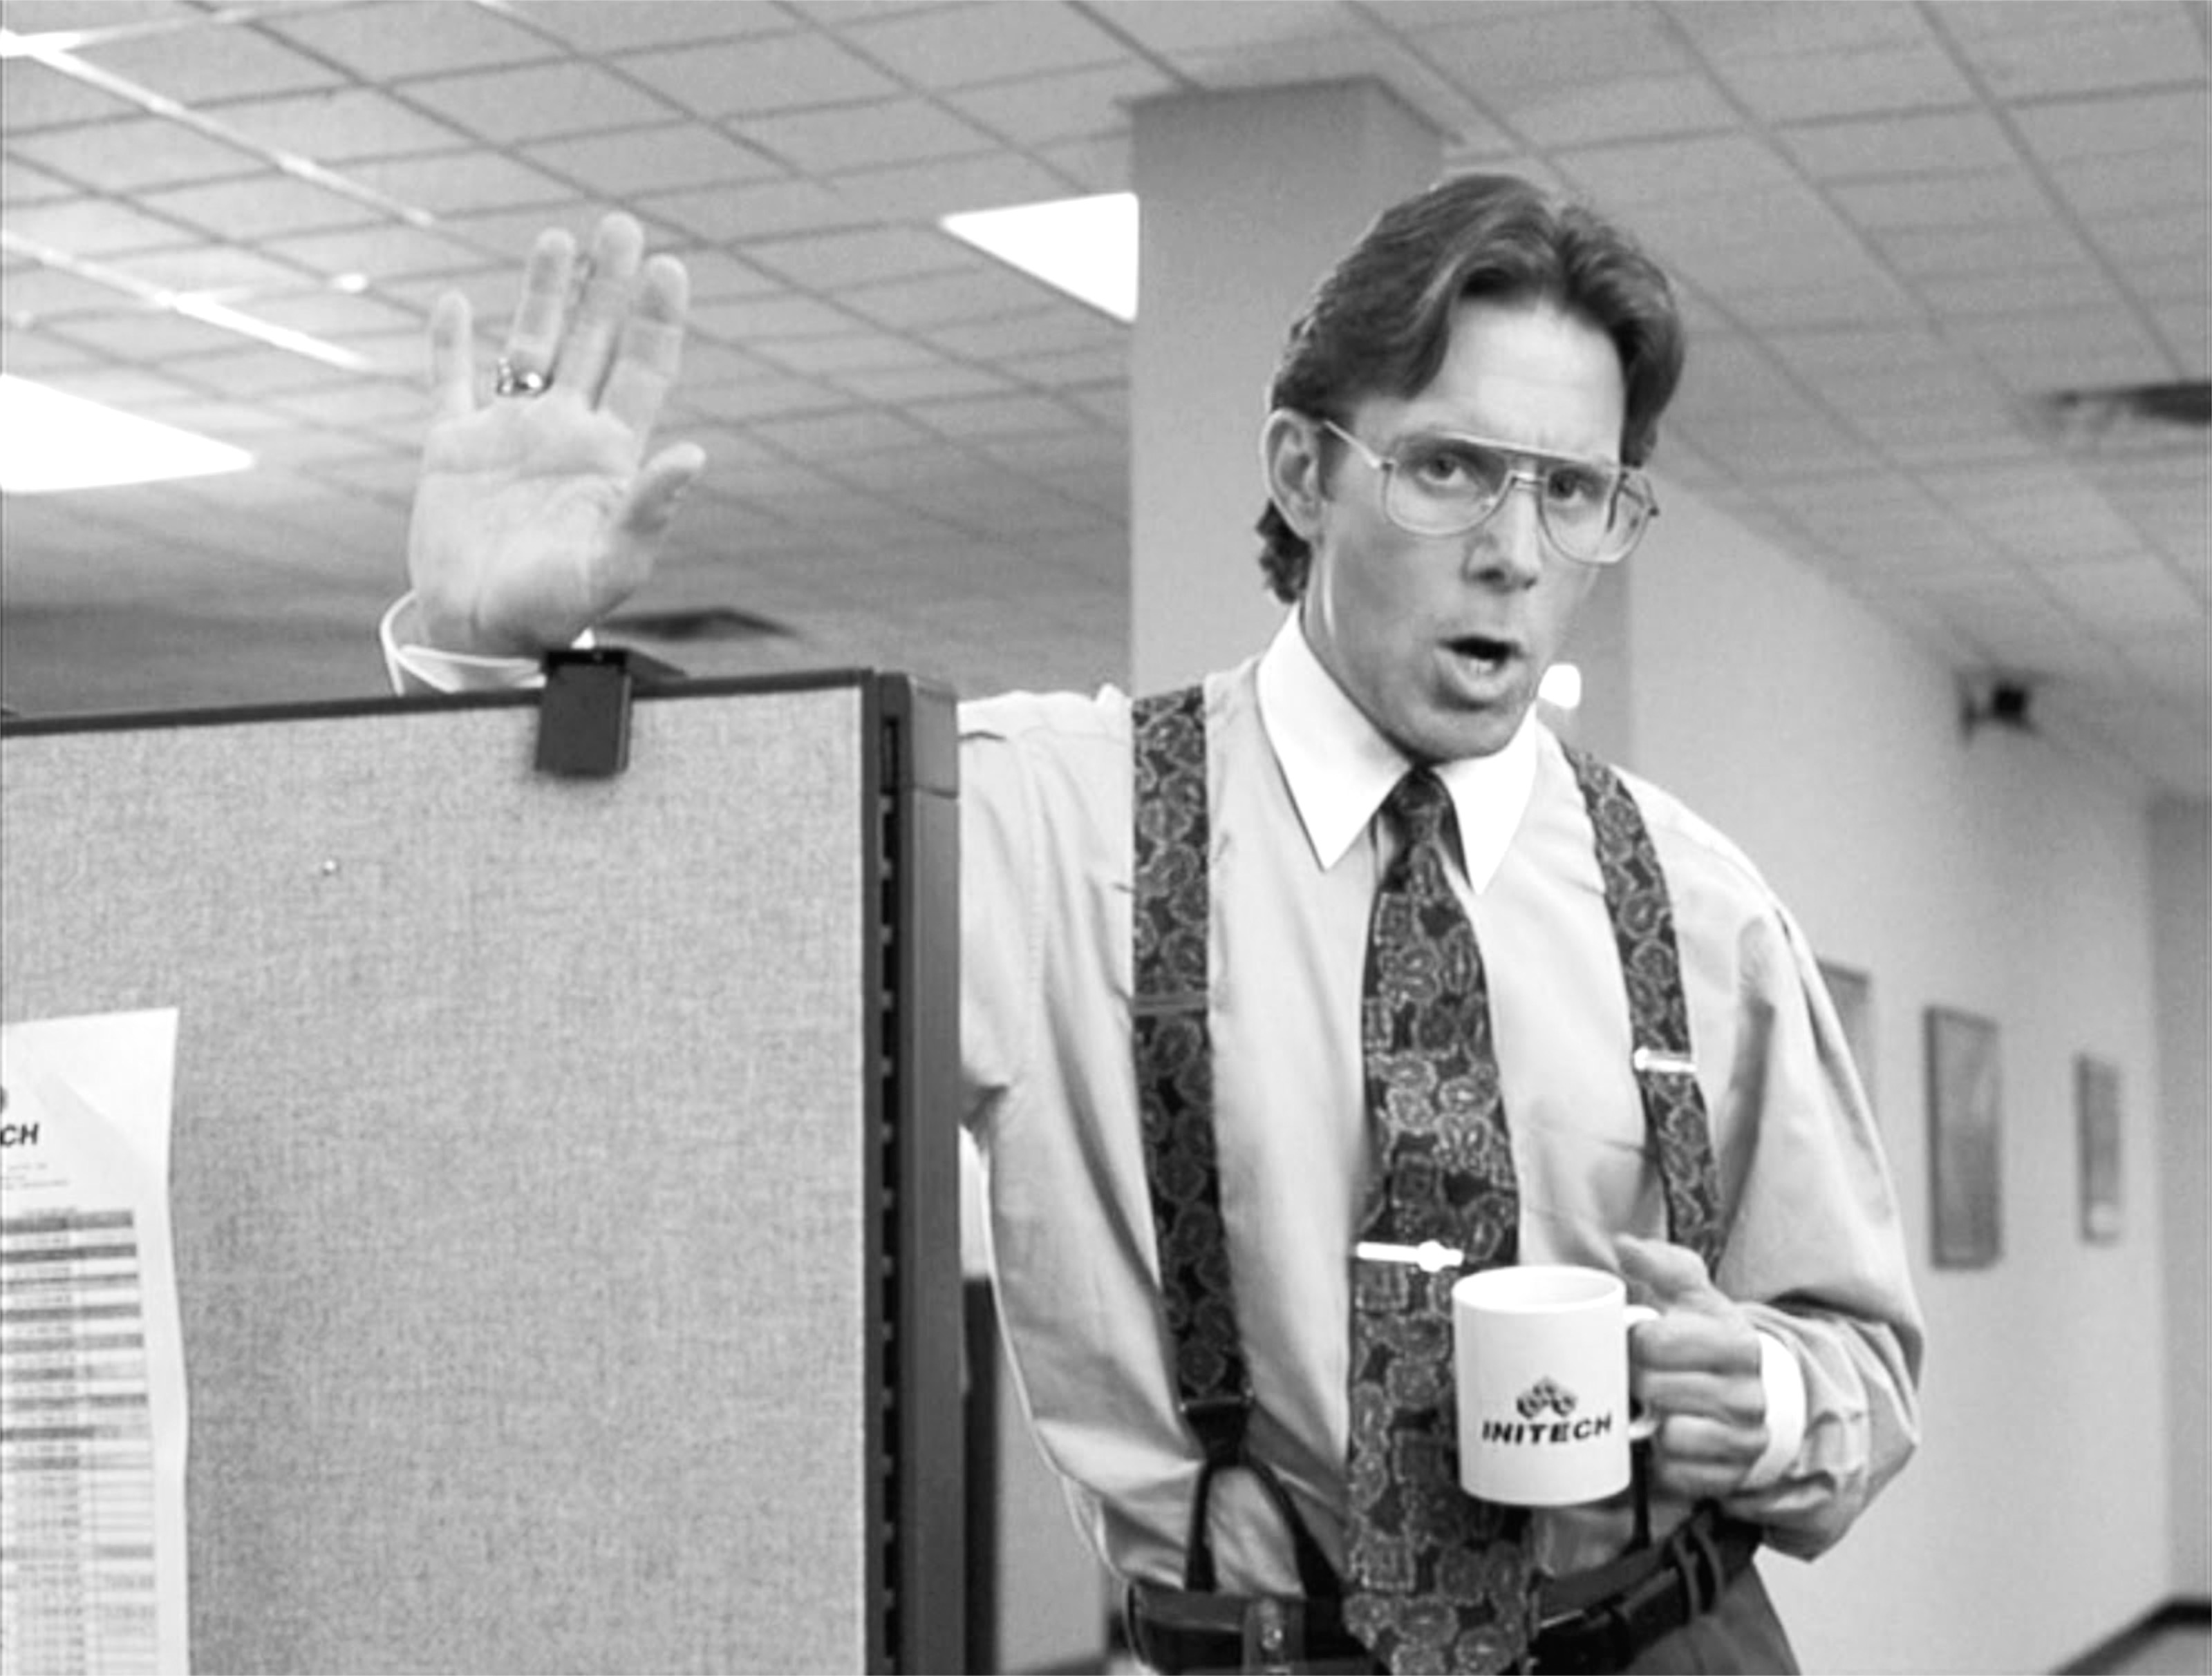
JUST
BETTER
THAN THE
REST OF THE OFFICE
Just one better than everyone else in the office

Slide 28
HOW ARE WE
GOING TO DO
THAT?

Slide 29
GENERATE
MILLIONS OF
BRACKETS

Slide 30

FILTER “BAD” BRACKETS

Slide 31
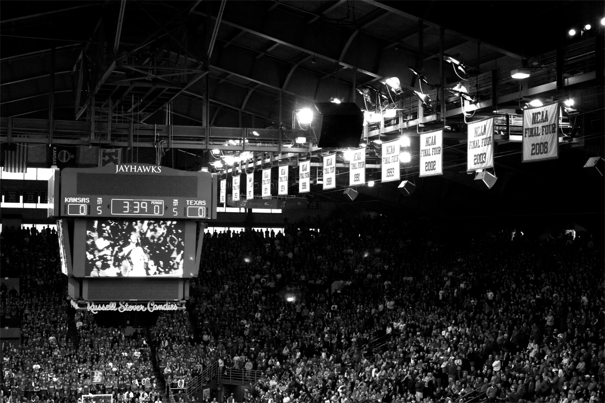
SCORE
THE
REMAINING

Slide 32
HOW
DO WE DO THIS?

Slide 33
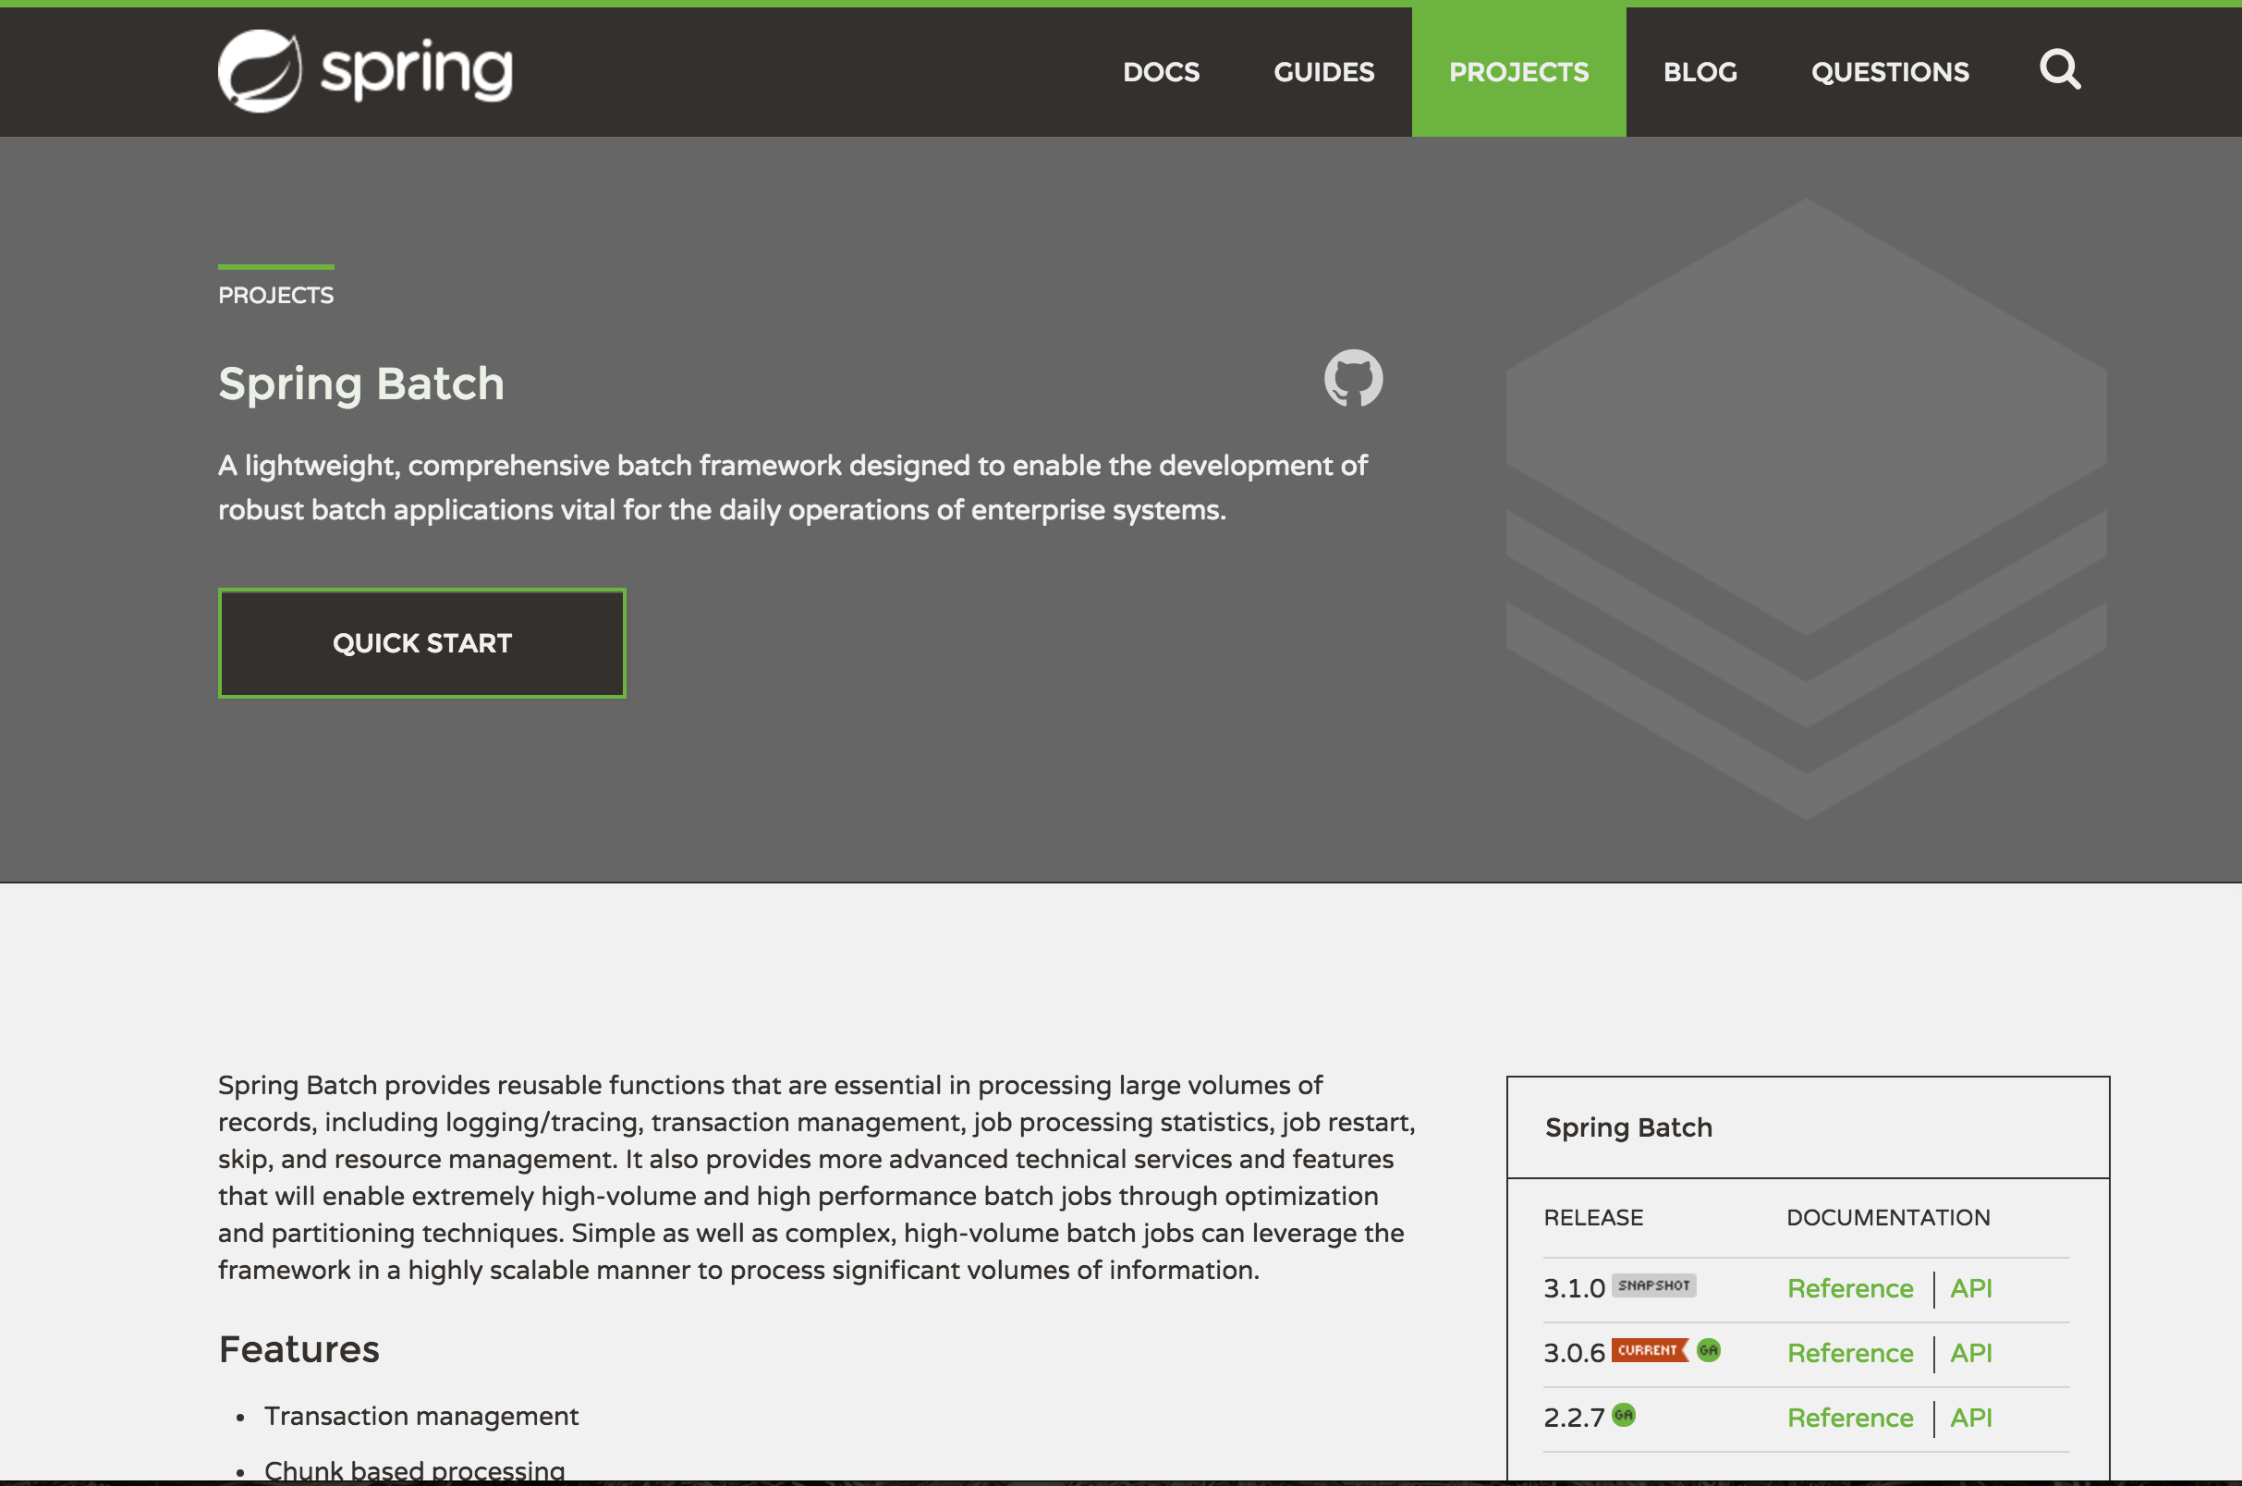
Spring Batch!

Slide 34
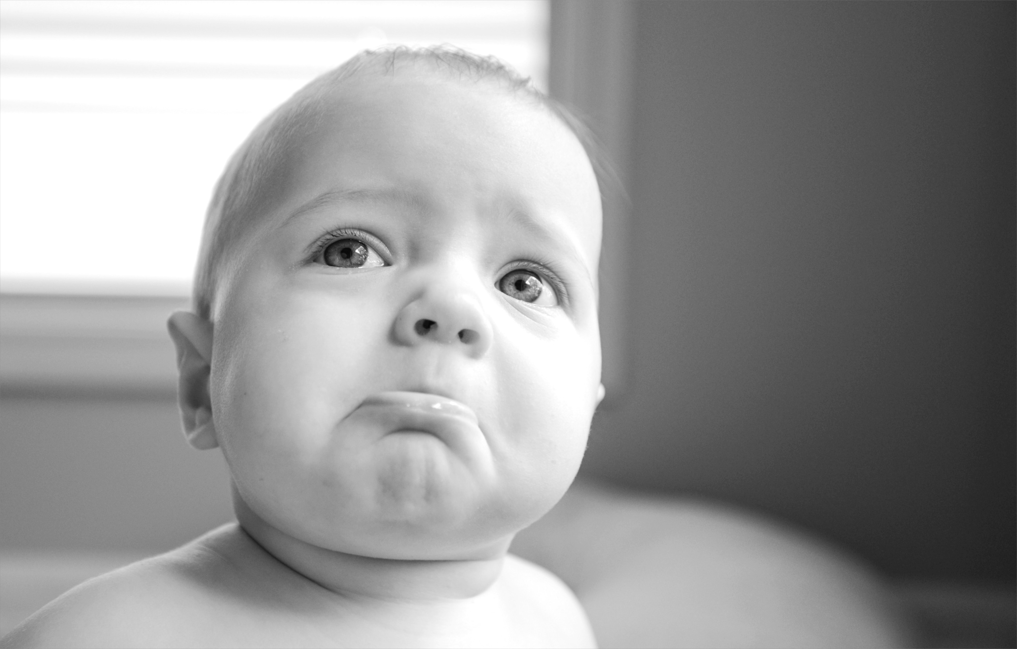
BATCH ISN’T
IDEAL
Not ideal
Notes:
https://www.flickr.com/photos/donnieray/9436653177

Slide 35
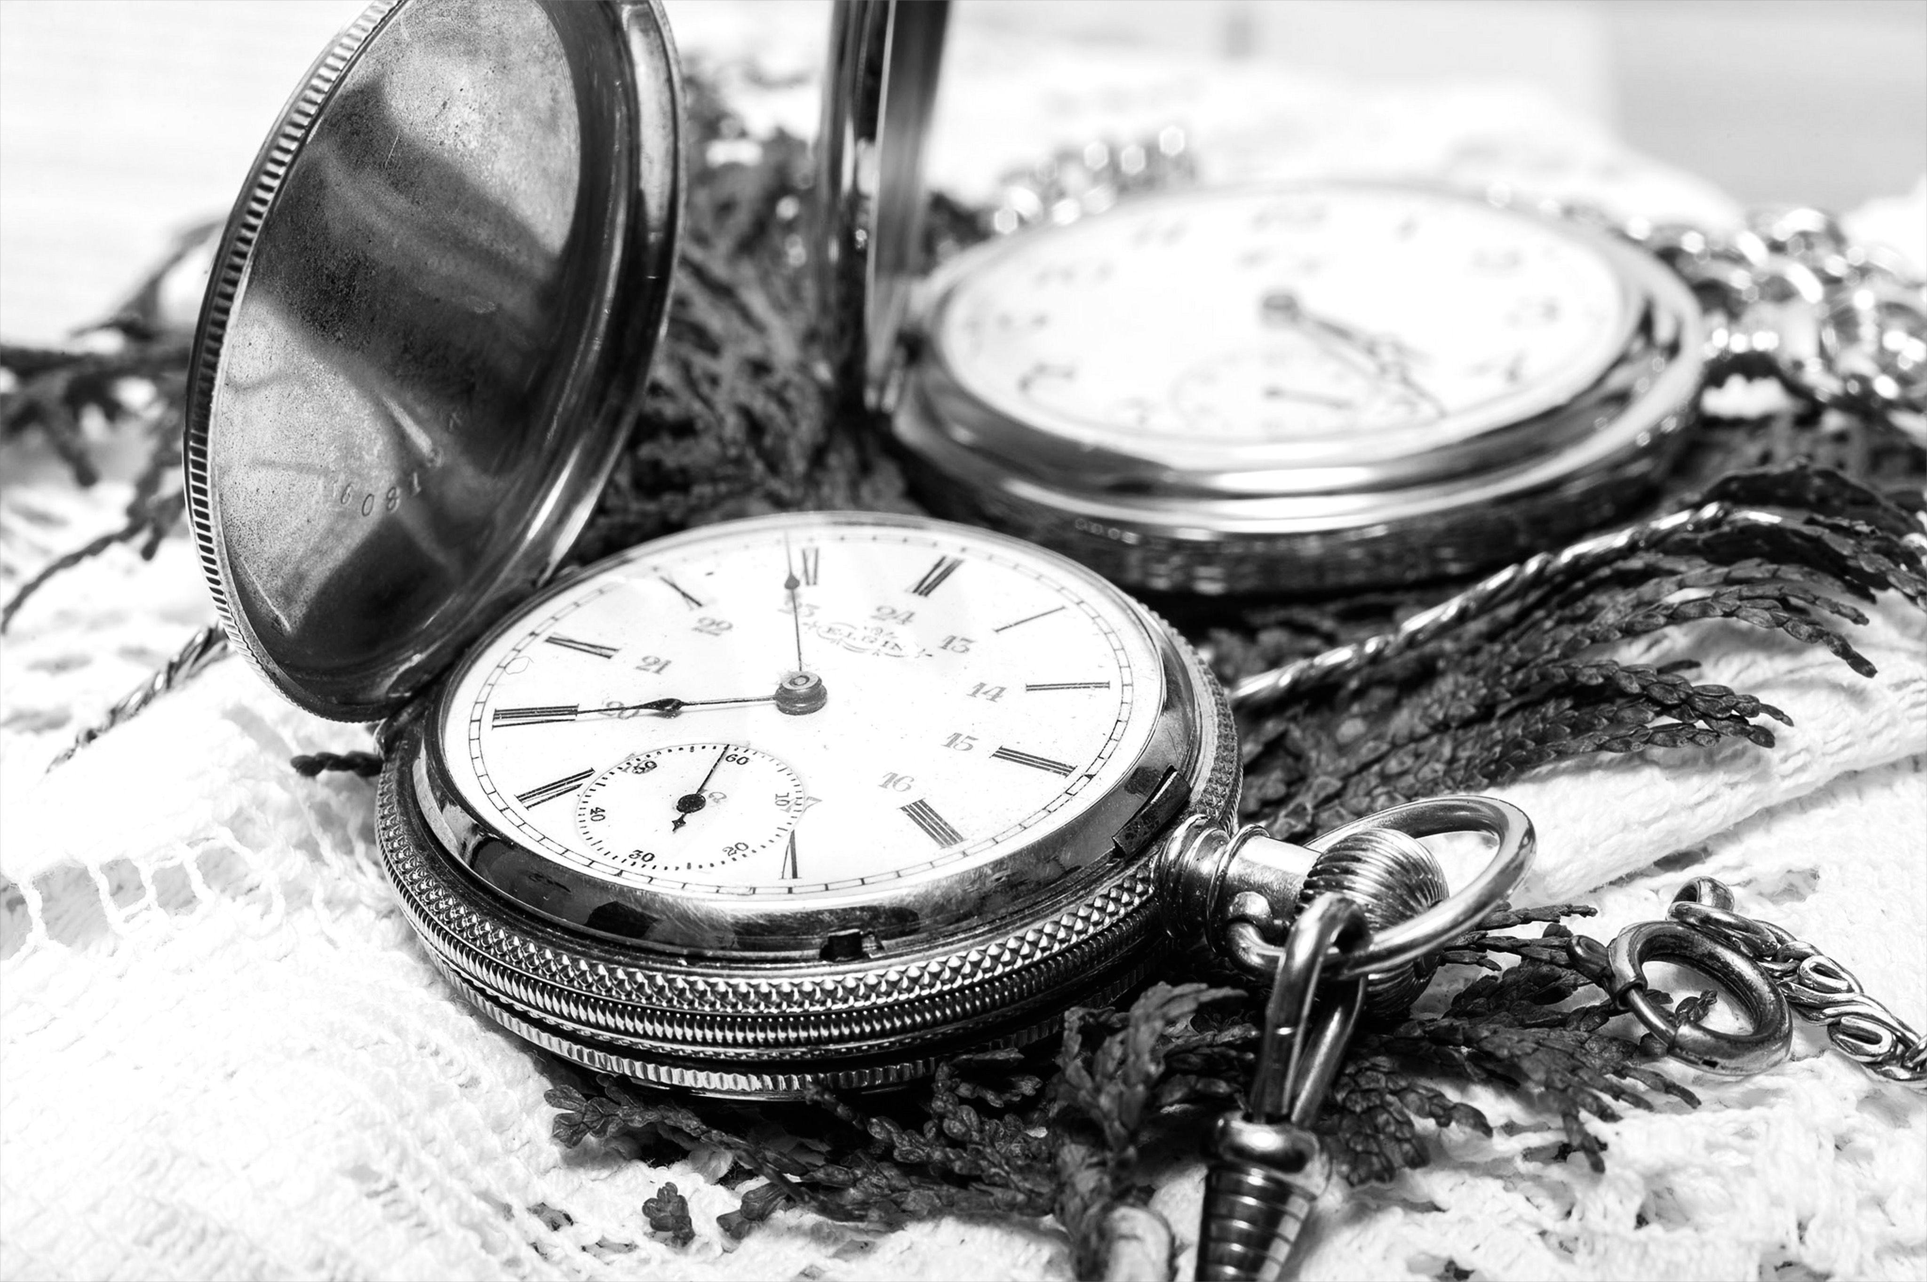
TASKS
RUN AT DIFFERENT TIMES
Notes:
https://www.flickr.com/photos/maybourne/11937207616/

Slide 36
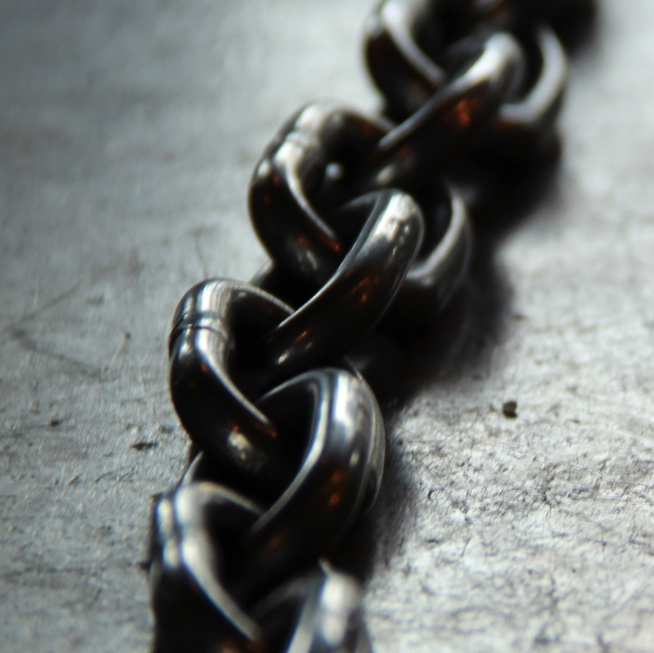
DIFFERENT STEPS
SHOULD BE
DECOUPLED

Slide 37
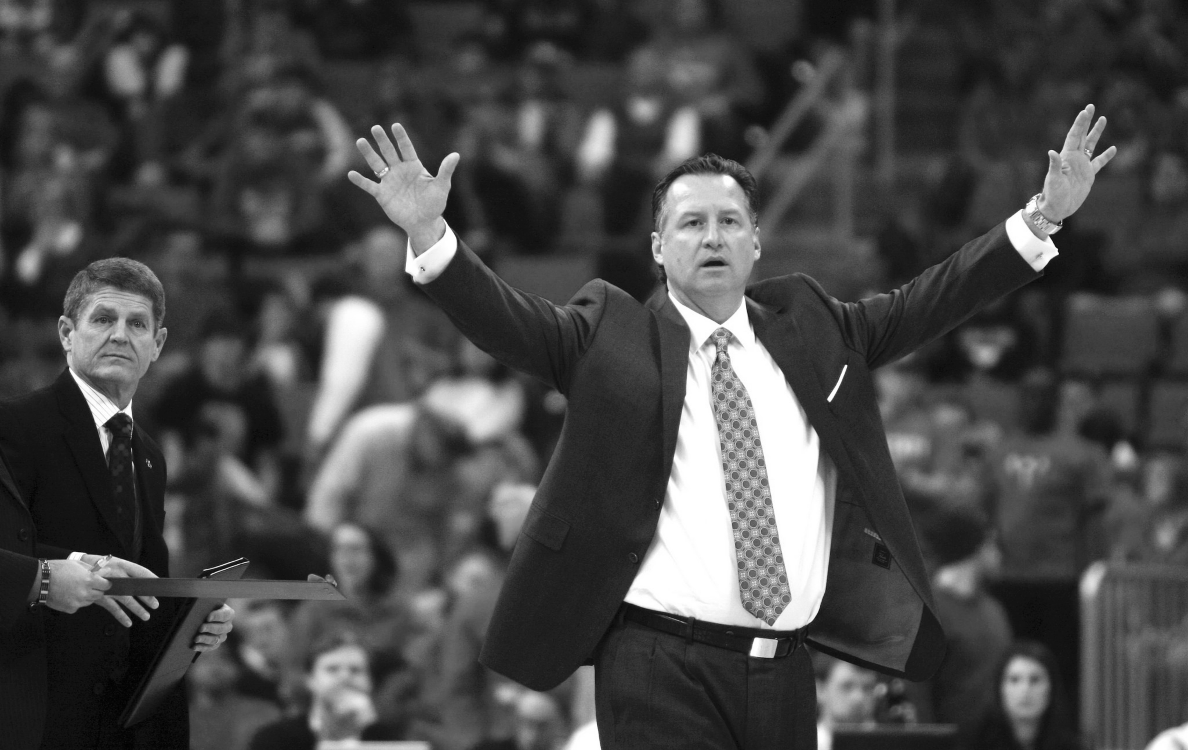
Orchestration should live at a higher level
ORCHESTRATION
OCCURS AT
A DIFFERENT LEVEL

Slide 38
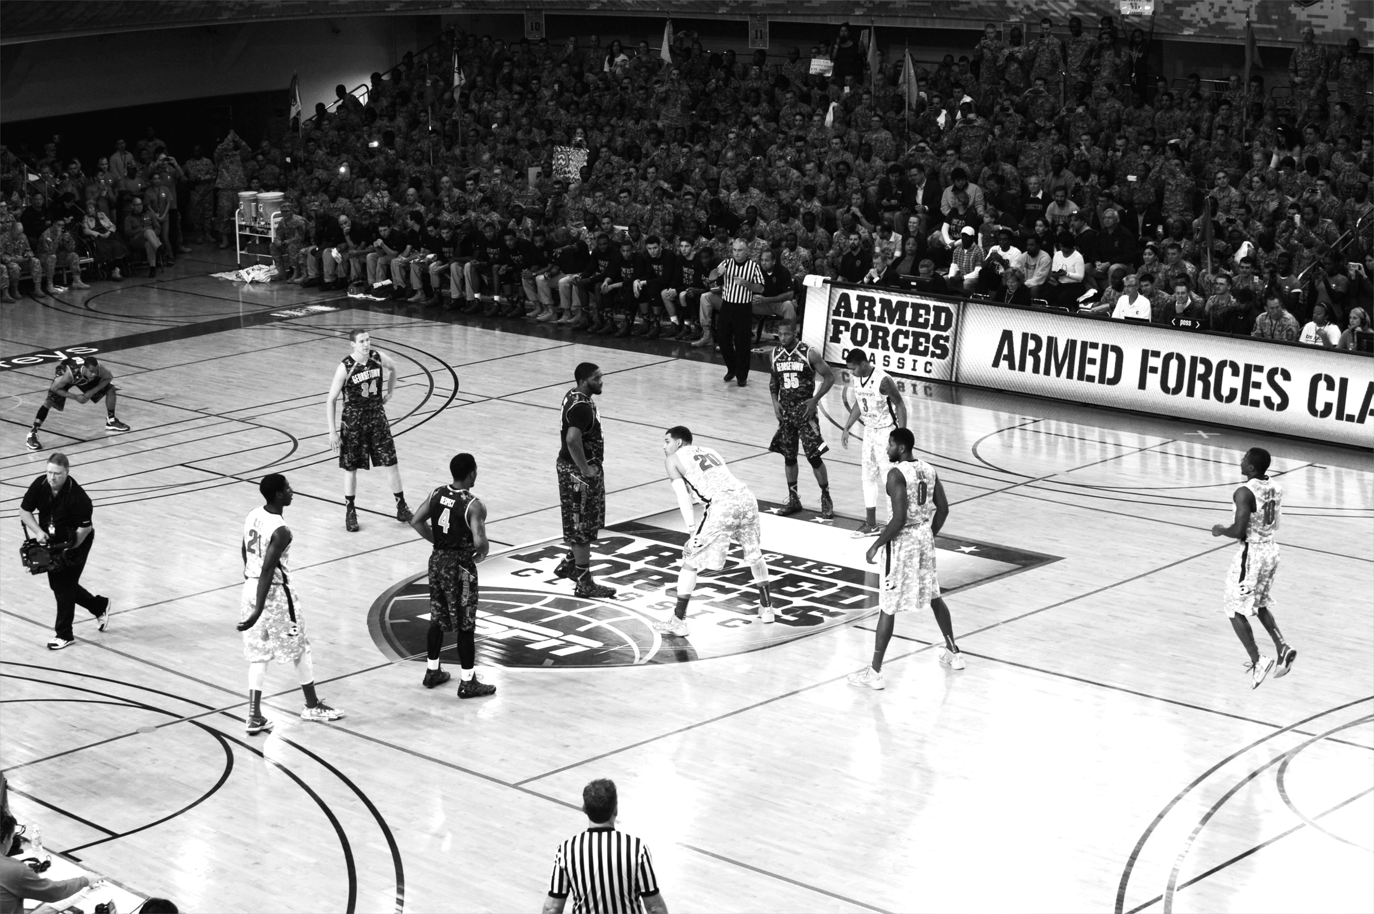
DISTRIBUTED DEPLOYMENT
OPTIONS
Notes:
https://www.flickr.com/photos/usaghumphreys/10917396866/

Slide 39
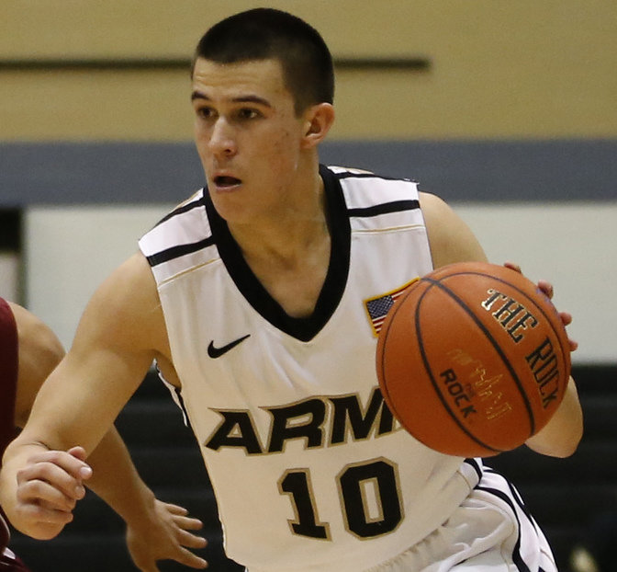
DEVELOP EACH
COMPONENT AS A
MICROSERVICE

Slide 40
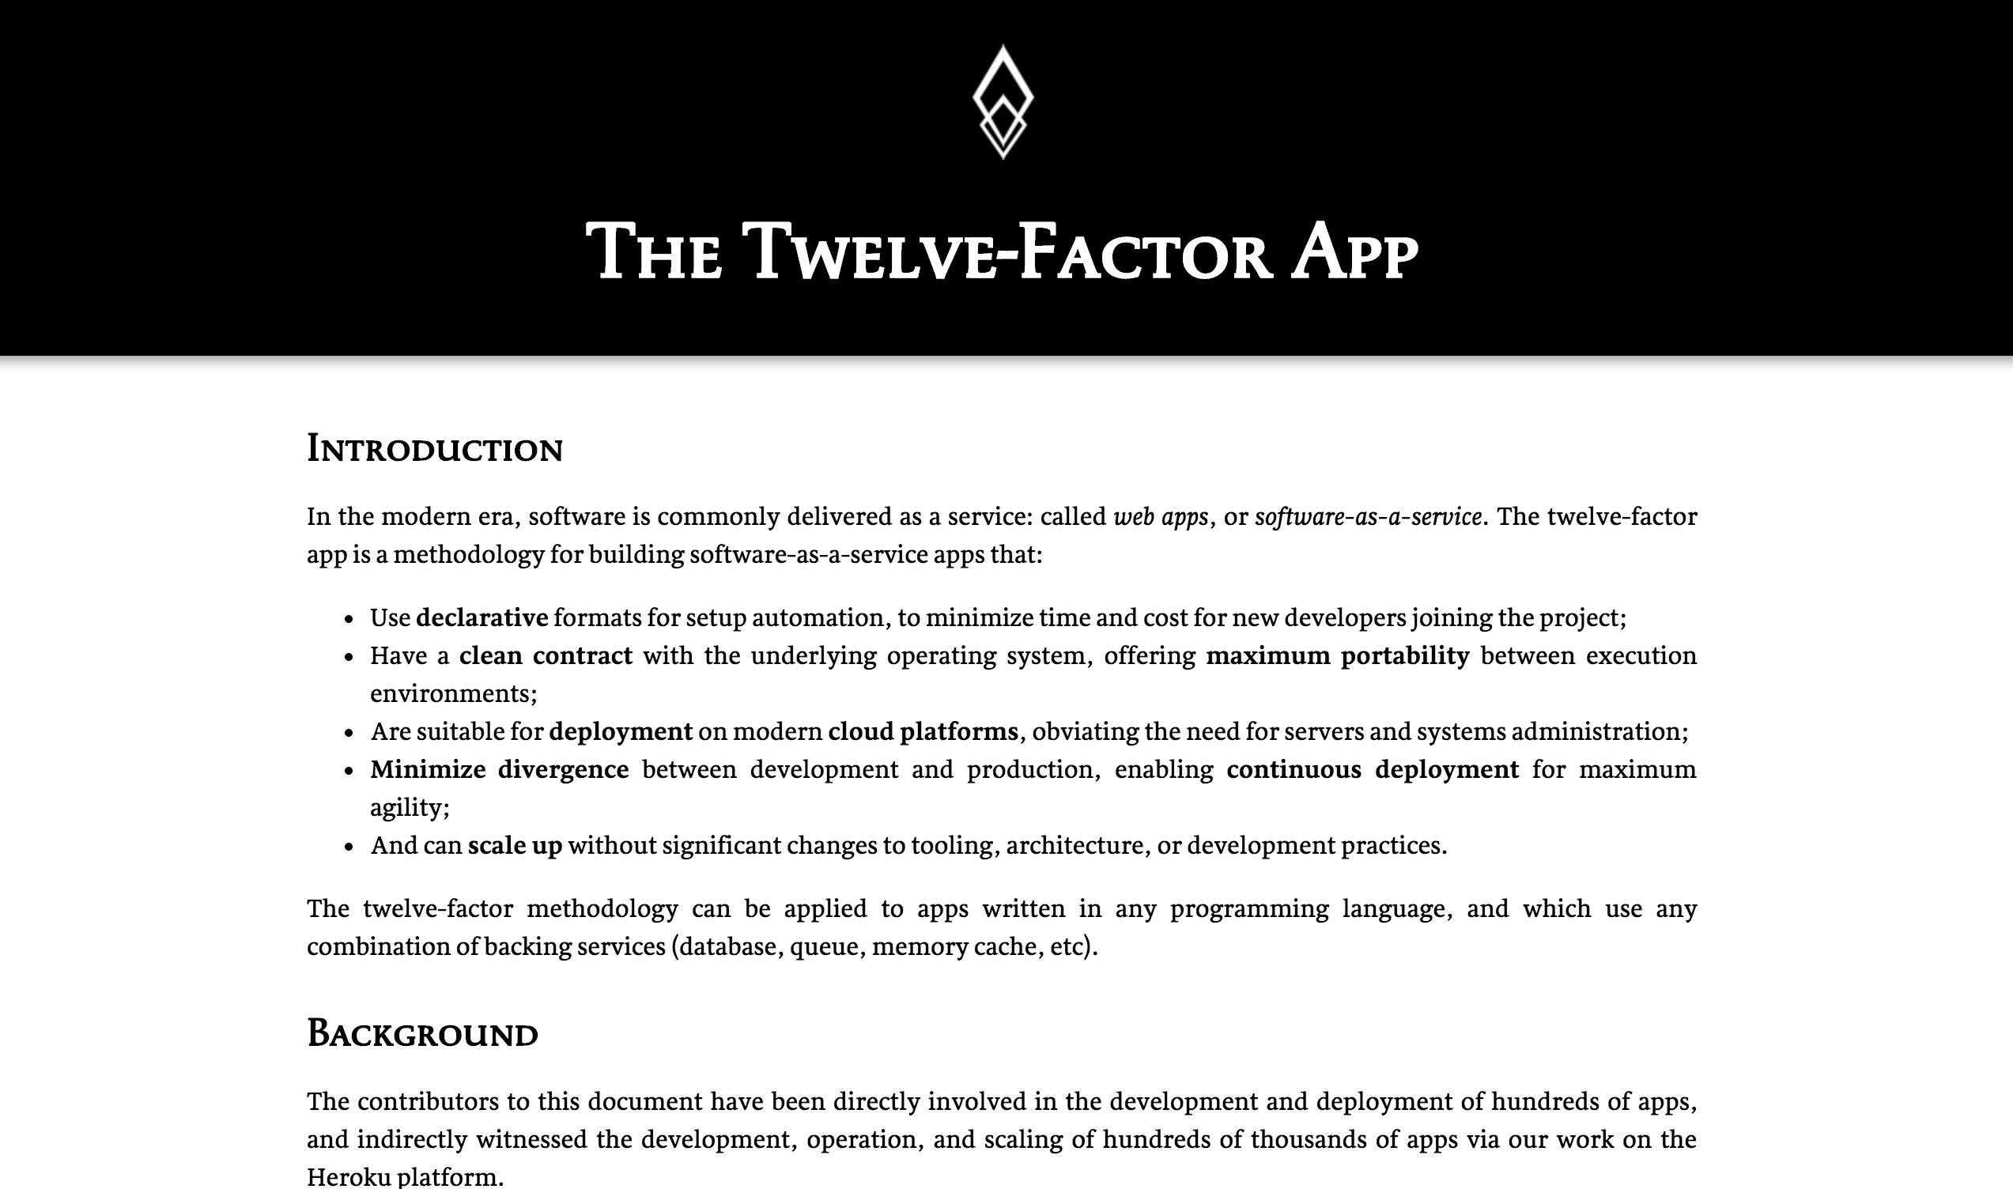
OBEY THE 12
FACTOR APP
PRINCIPALS

Slide 41
Data microservices

Slide 42
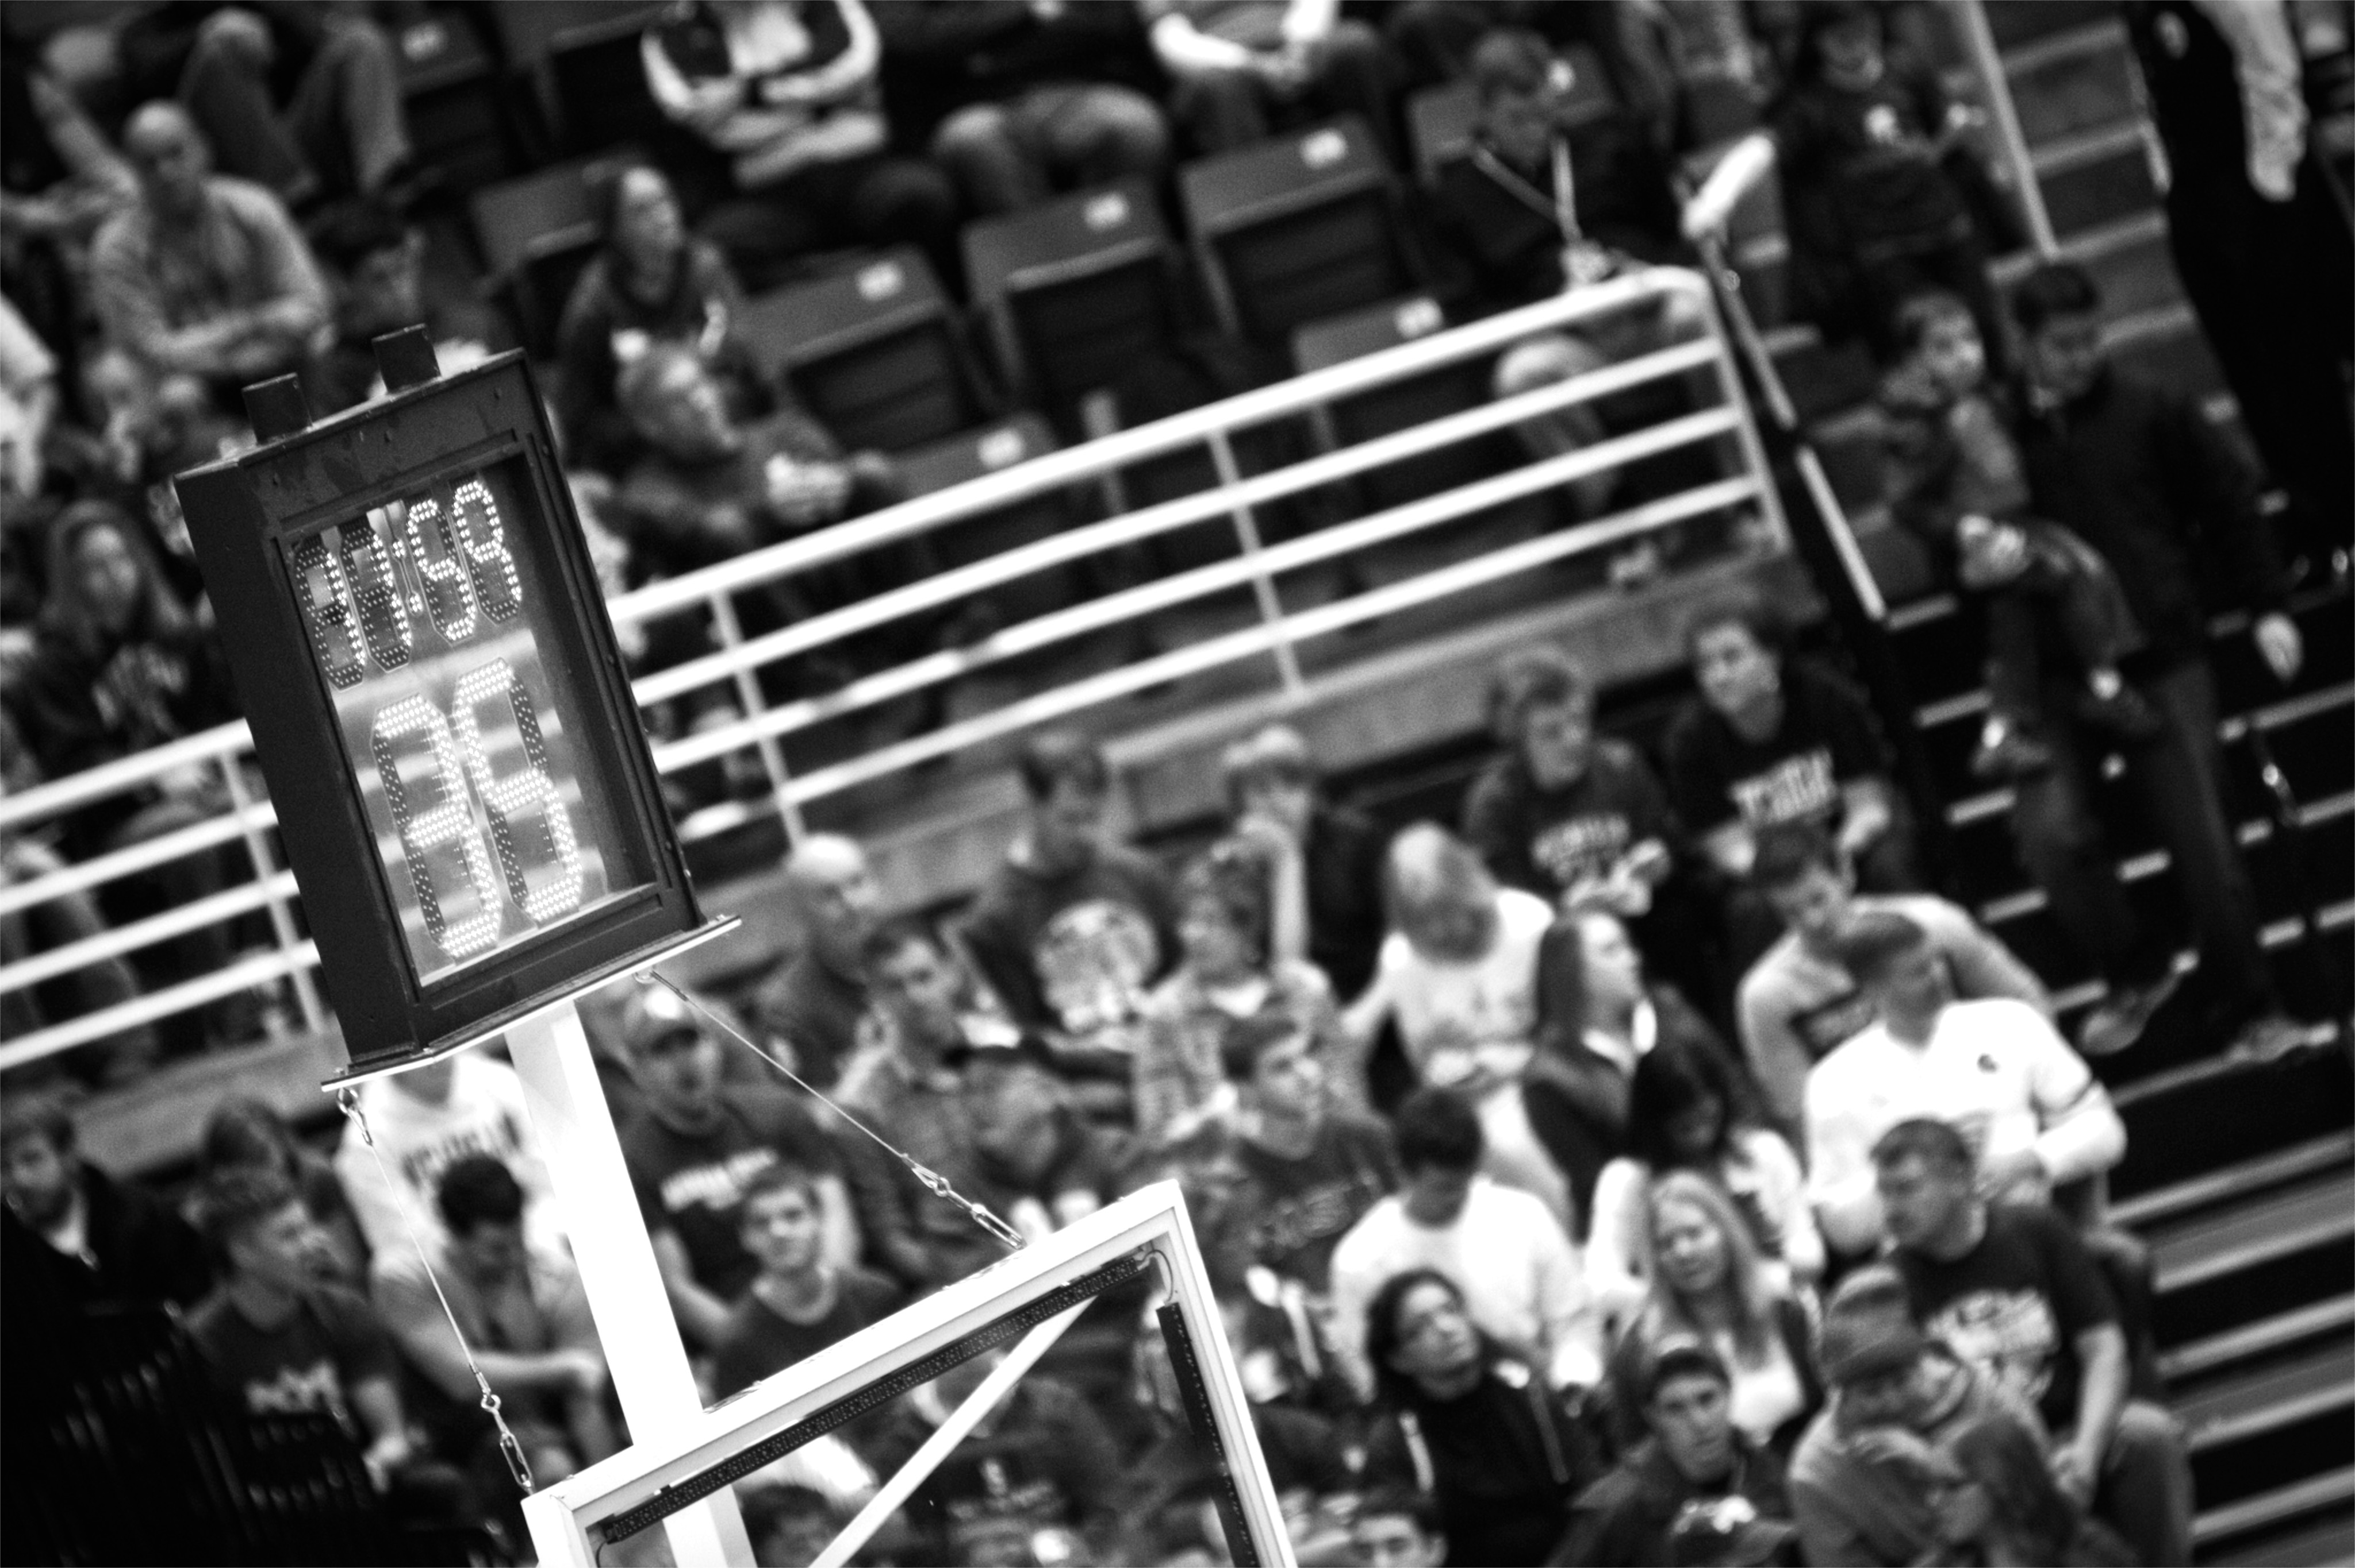
JUST
SHORT LIVED
Notes:
https://www.flickr.com/photos/maybourne/11937207616/

Slide 43
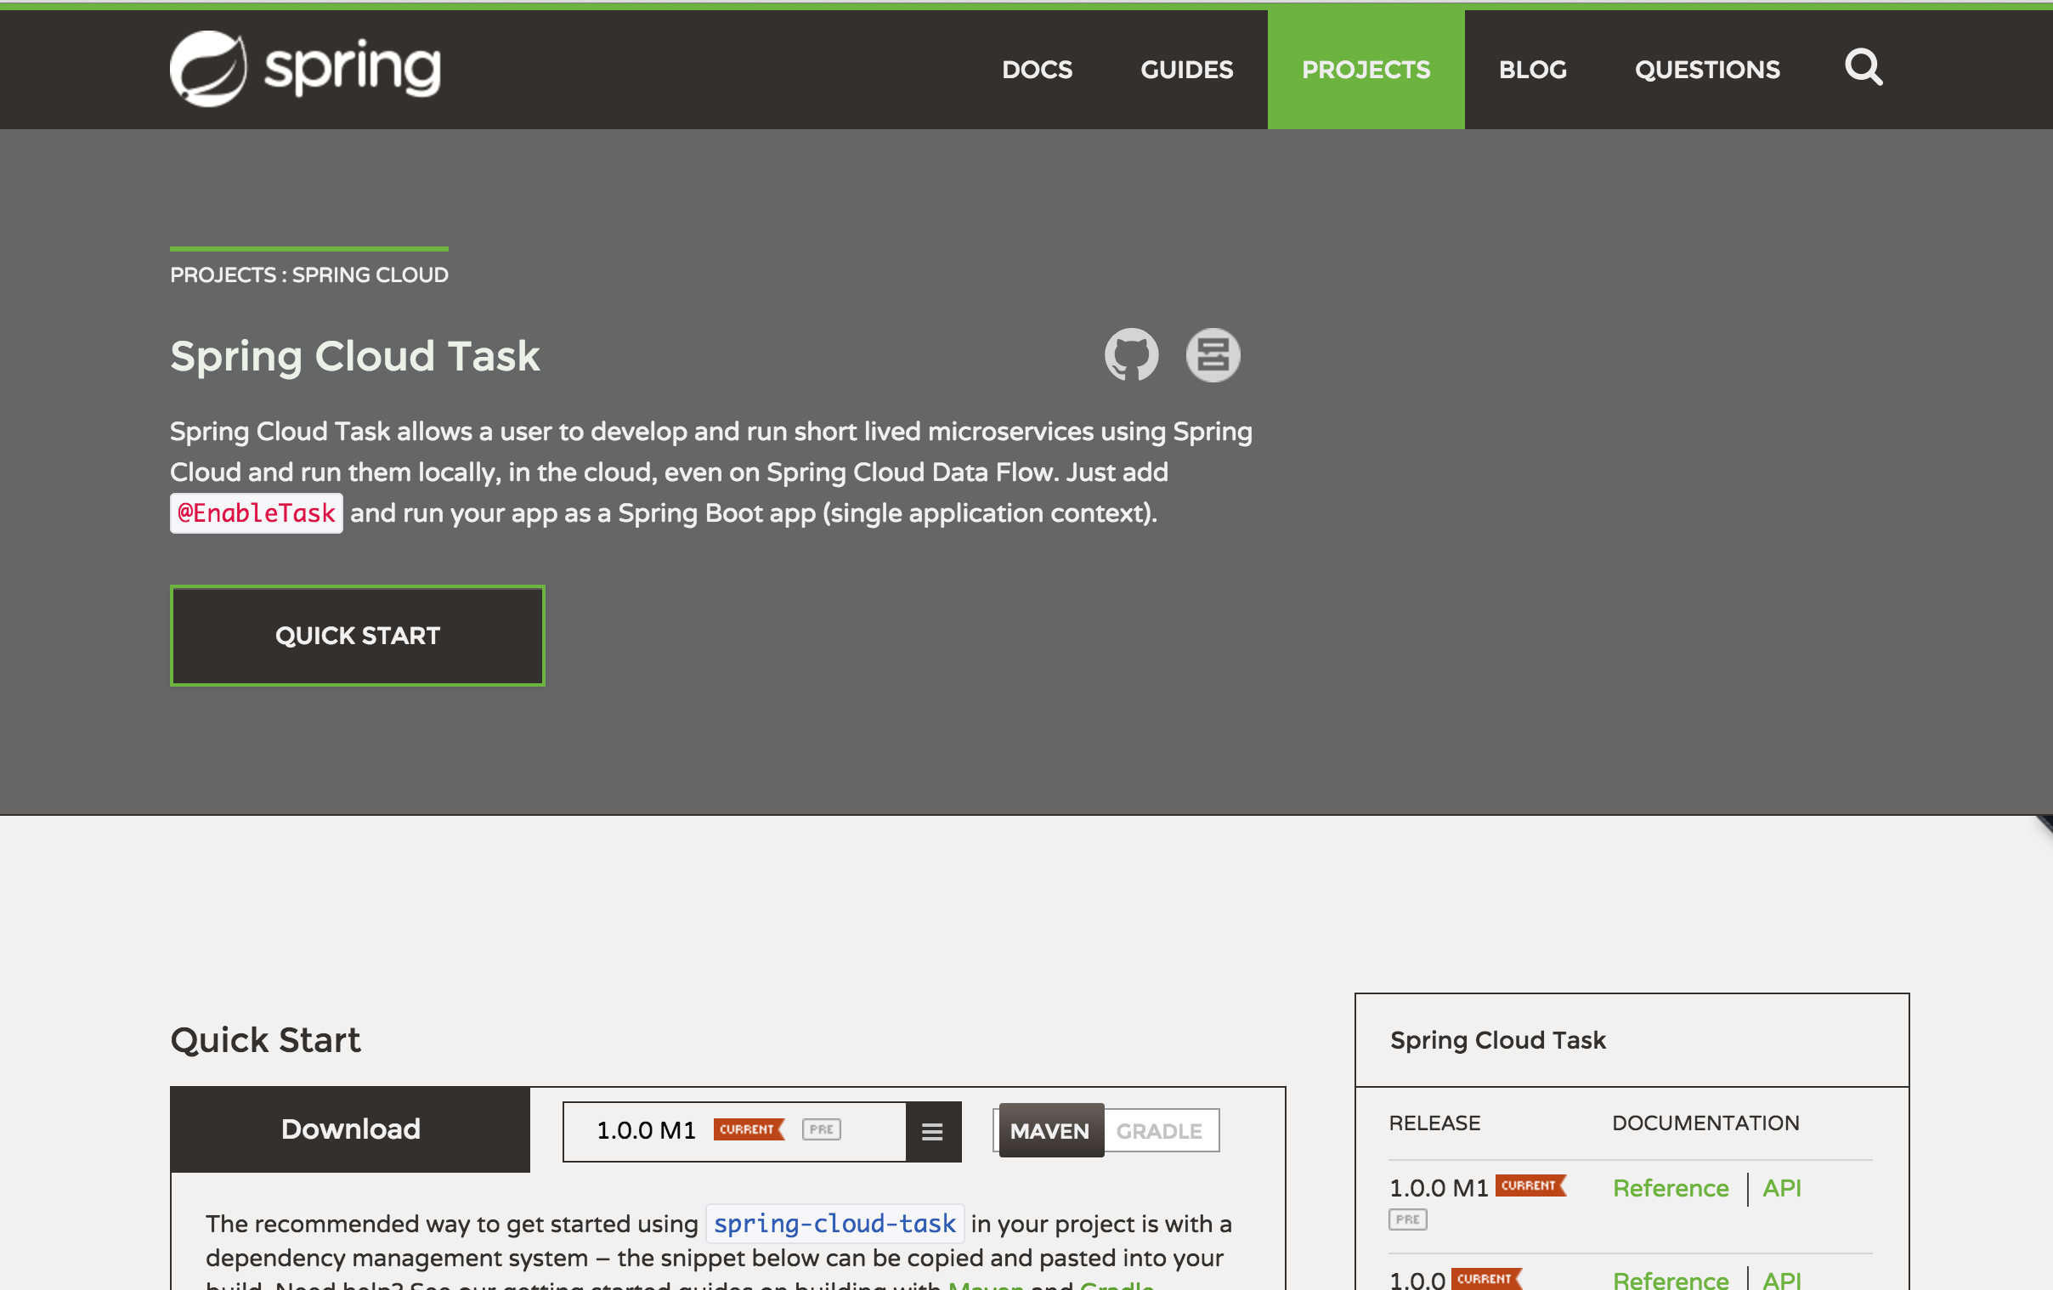

Slide 44

A framework for providing functional and nonfunctional features
for building short lived microservices.

Slide 45
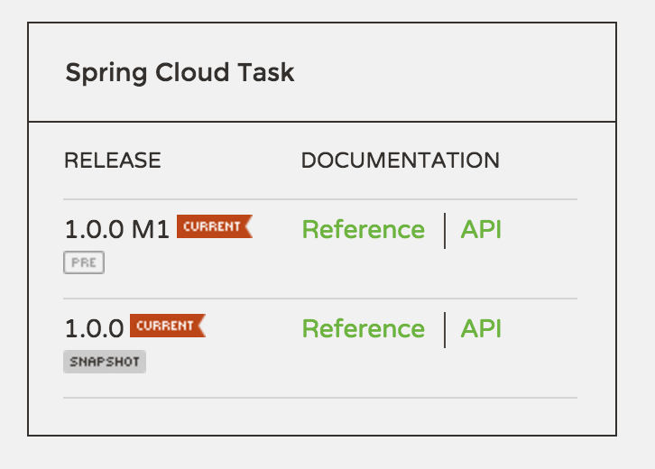
CURRENT VERSION
1.0.1.RELEASE

Slide 46
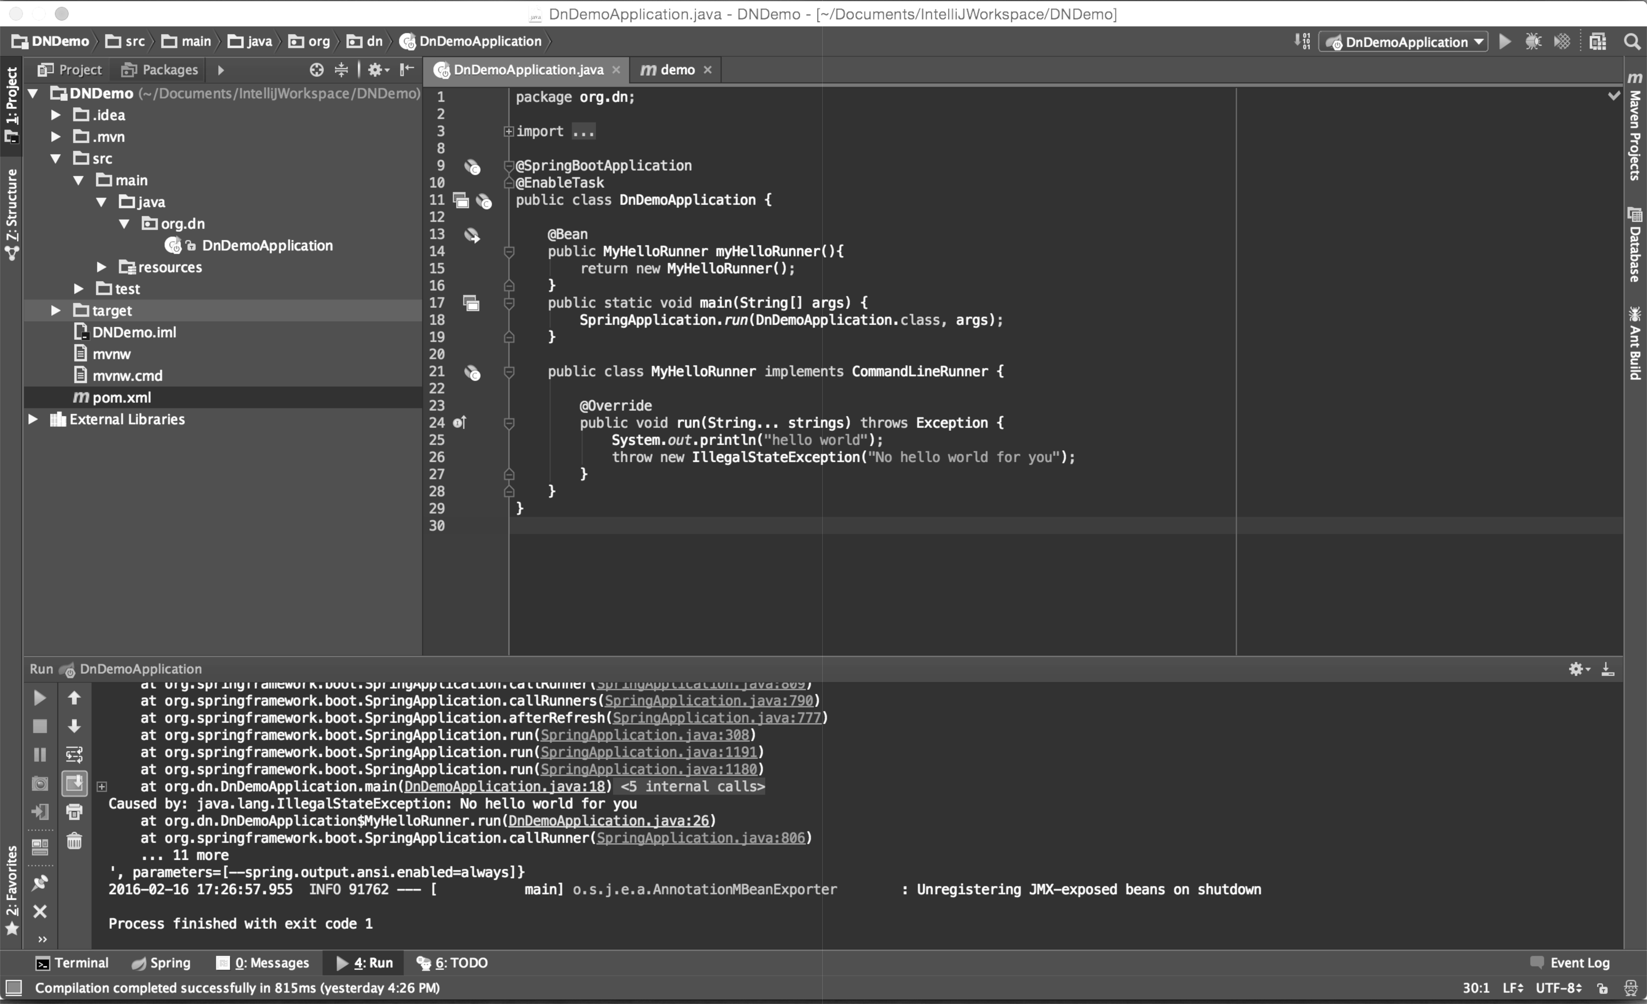
HELLO
WORLD!
Hello World of Spring Cloud Task

Slide 47
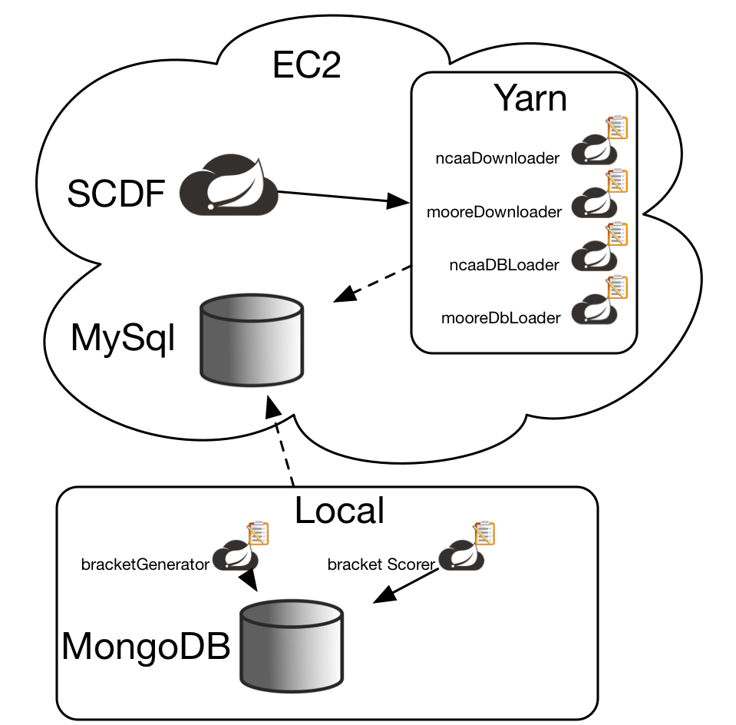

Slide 48
Demo
DEMO

Slide 49
ROADMAP

Slide 50
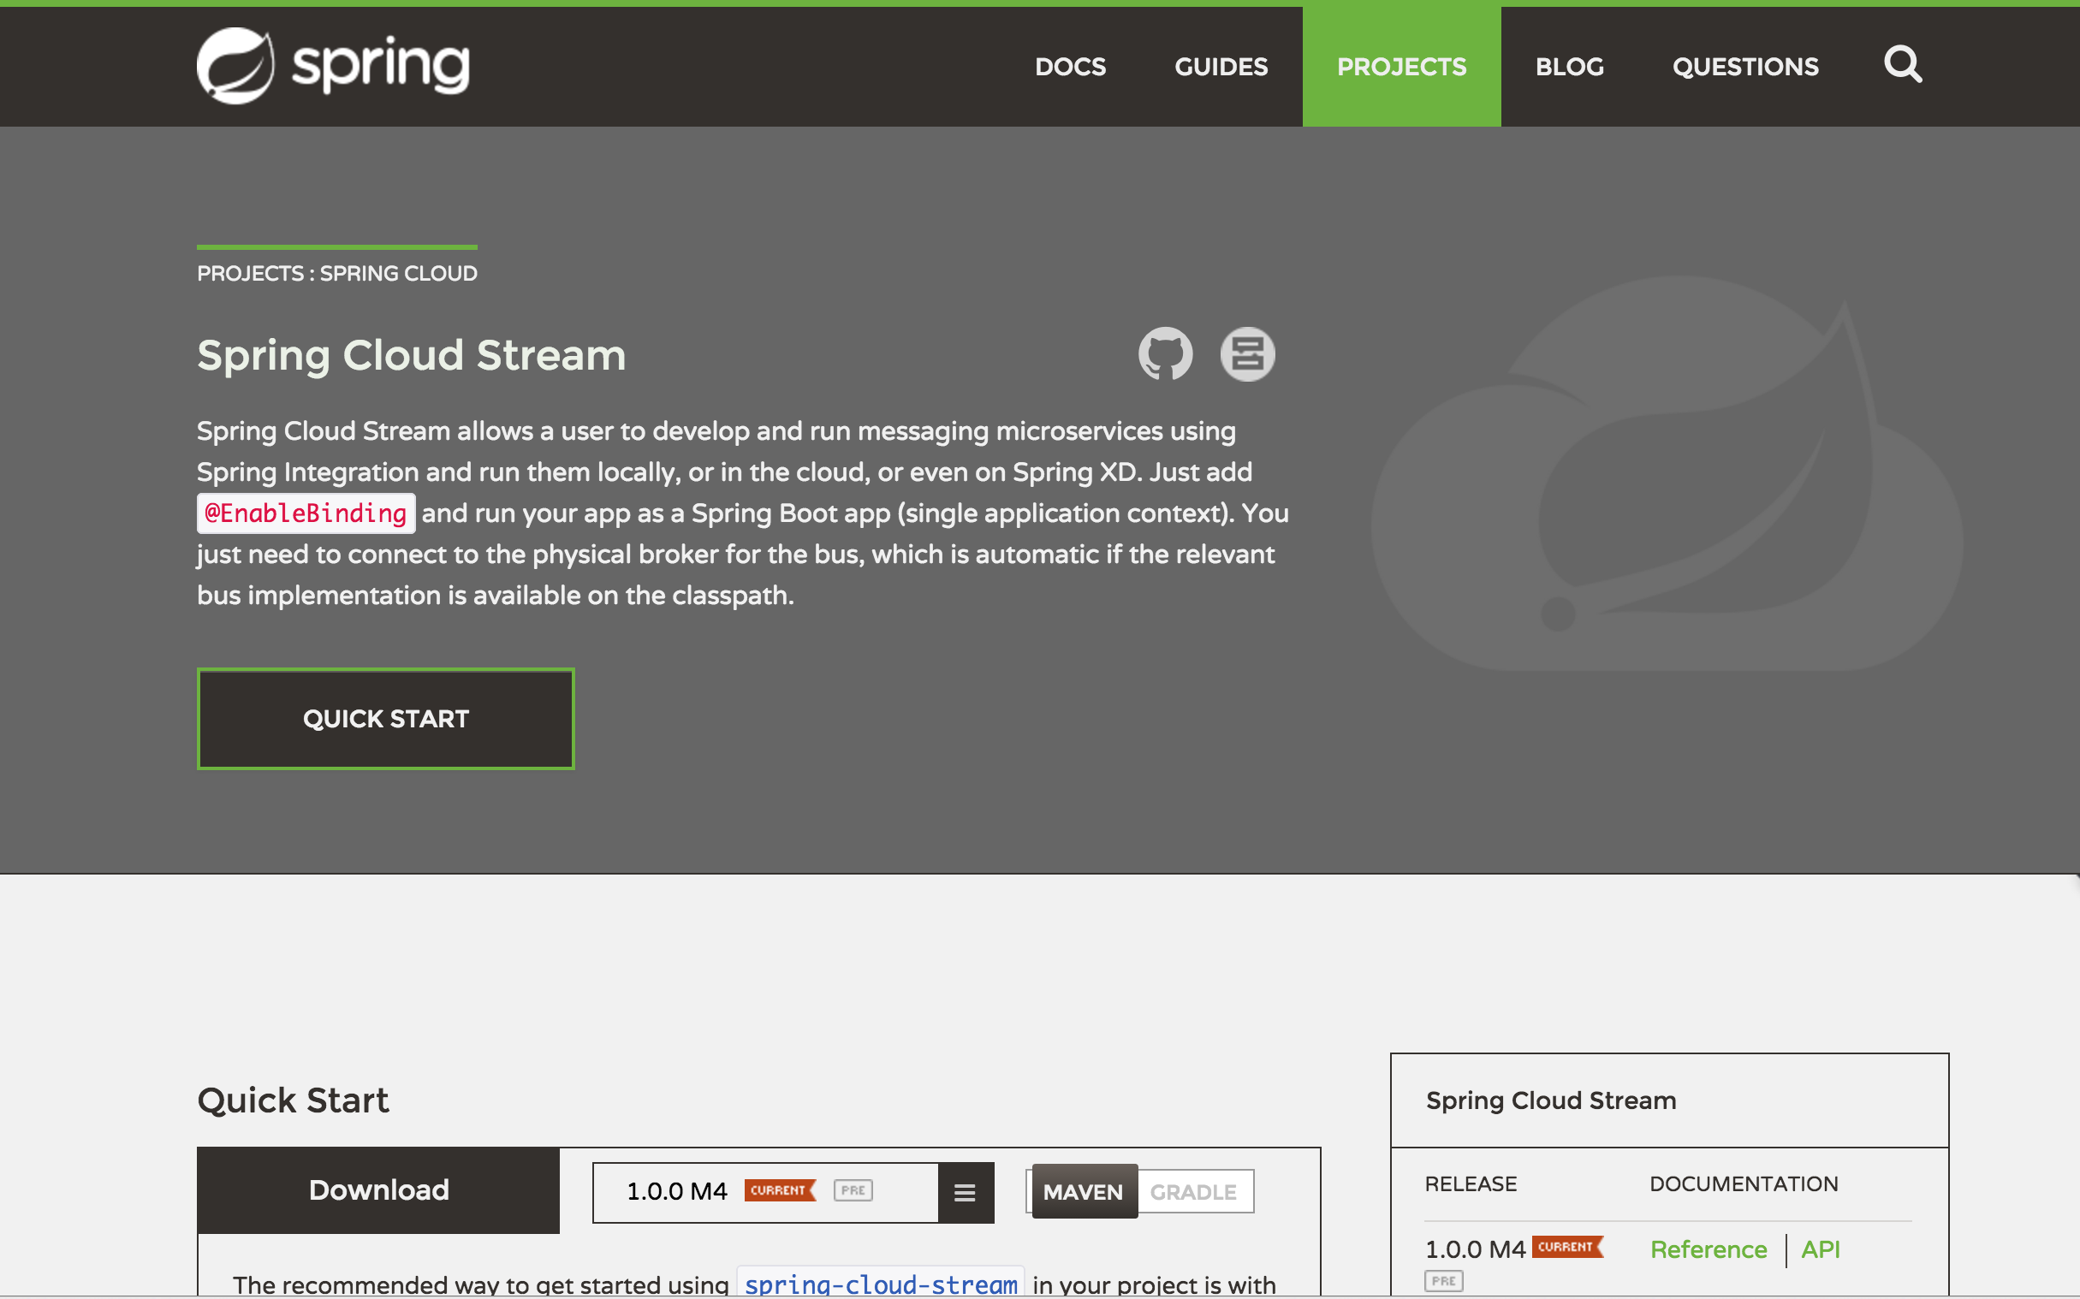
Spring Cloud Stream integration

Slide 51
Spring Batch!

Slide 52
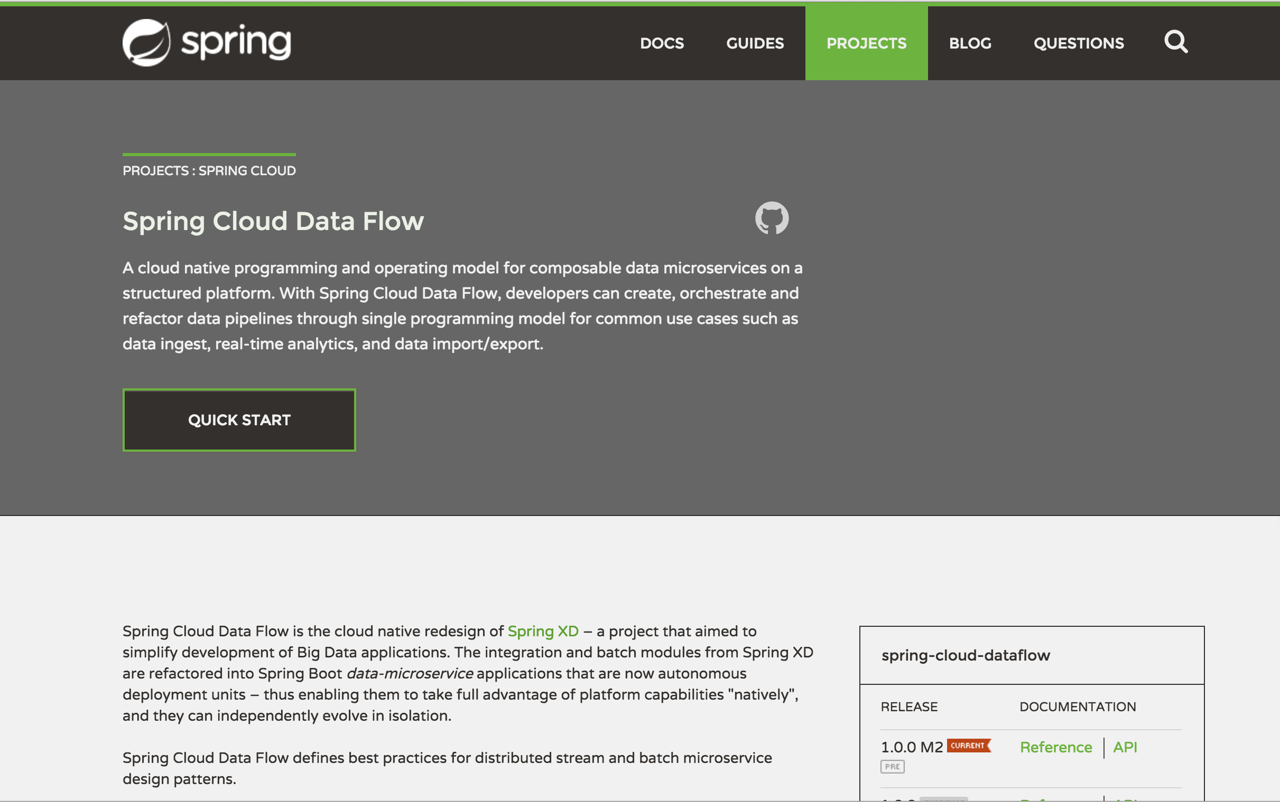
Notes:
Call out tasks replace jobs in SCDF from XD

Slide 53
1.0.0.M2
EARLY NEXT MONTH

Slide 54
1.0.0.RELEASE (GA)
SECOND QUARTER

Slide 55

QUESTIONS?

Slide 56
THANKS!

